Slide 1














Linking demographics and geography:
Using gridded population to gain spatial insights in R
Edith Darin, Research Fellow
Southampton, UK

Slide 2


What is your background?
ⓘ Start presenting to display the poll results on this slide.

Slide 3
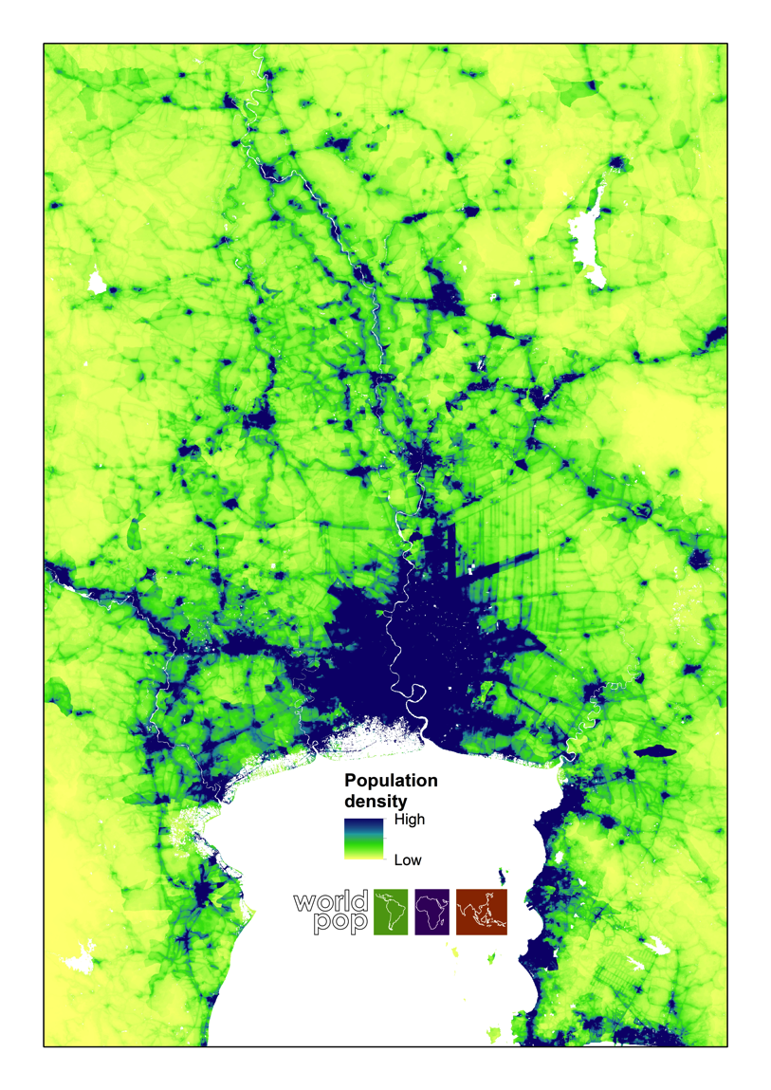
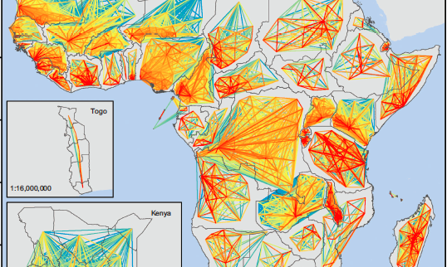
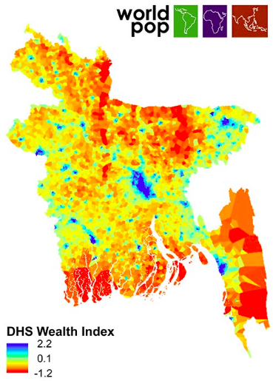

WorldPop, University of Southampton
University research program developing open-access, high-resolution spatial demographic datasets for low- and middle-income countries to support development, disaster response and health applications.
Population mobility
Population counts
Population characteristics

Slide 4

Have you already worked with geographical data? (before the SICSS)
ⓘ Start presenting to display the poll results on this slide.

Slide 5
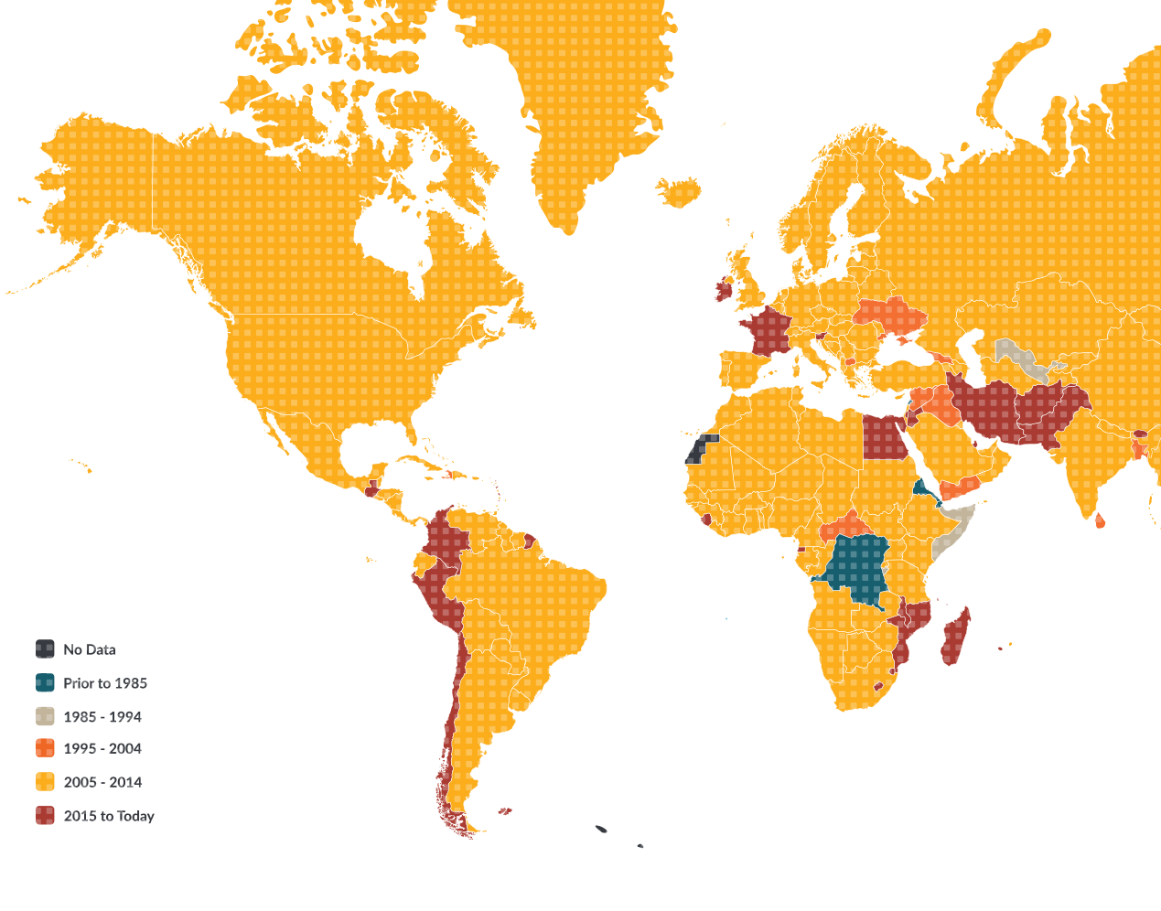
Population data
Data may have limitations that prevent their use.
Data become obsolete during the intercensal period
Data have limited coverage of the country
Aggregation of data results in loss of information.
Last census (UNFPA 2019).

Slide 6

Which population data have you already used and at which scale?
ⓘ Start presenting to display the poll results on this slide.

Slide 7



Spatial resolution of demographic data

Slide 8
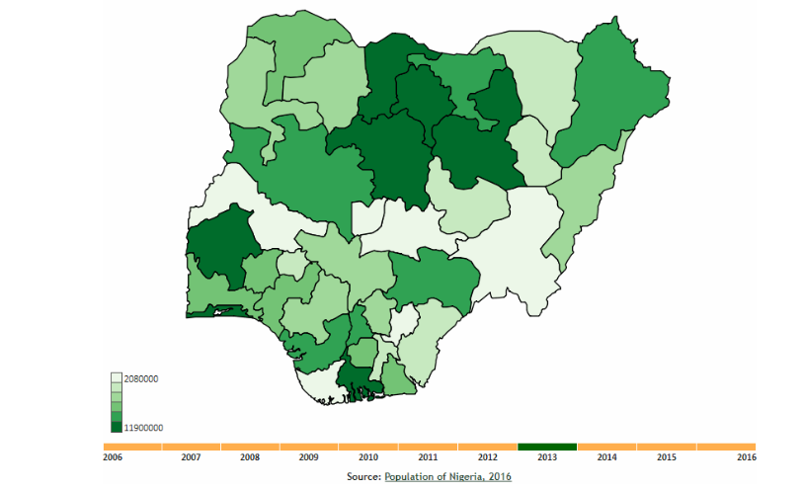
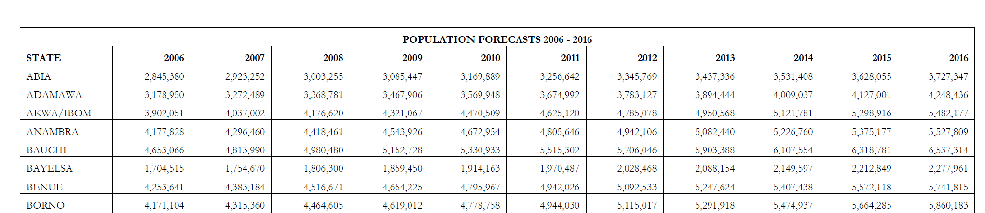
Data from the National Bureau of Statistics
Challenges with traditional population data

Slide 9
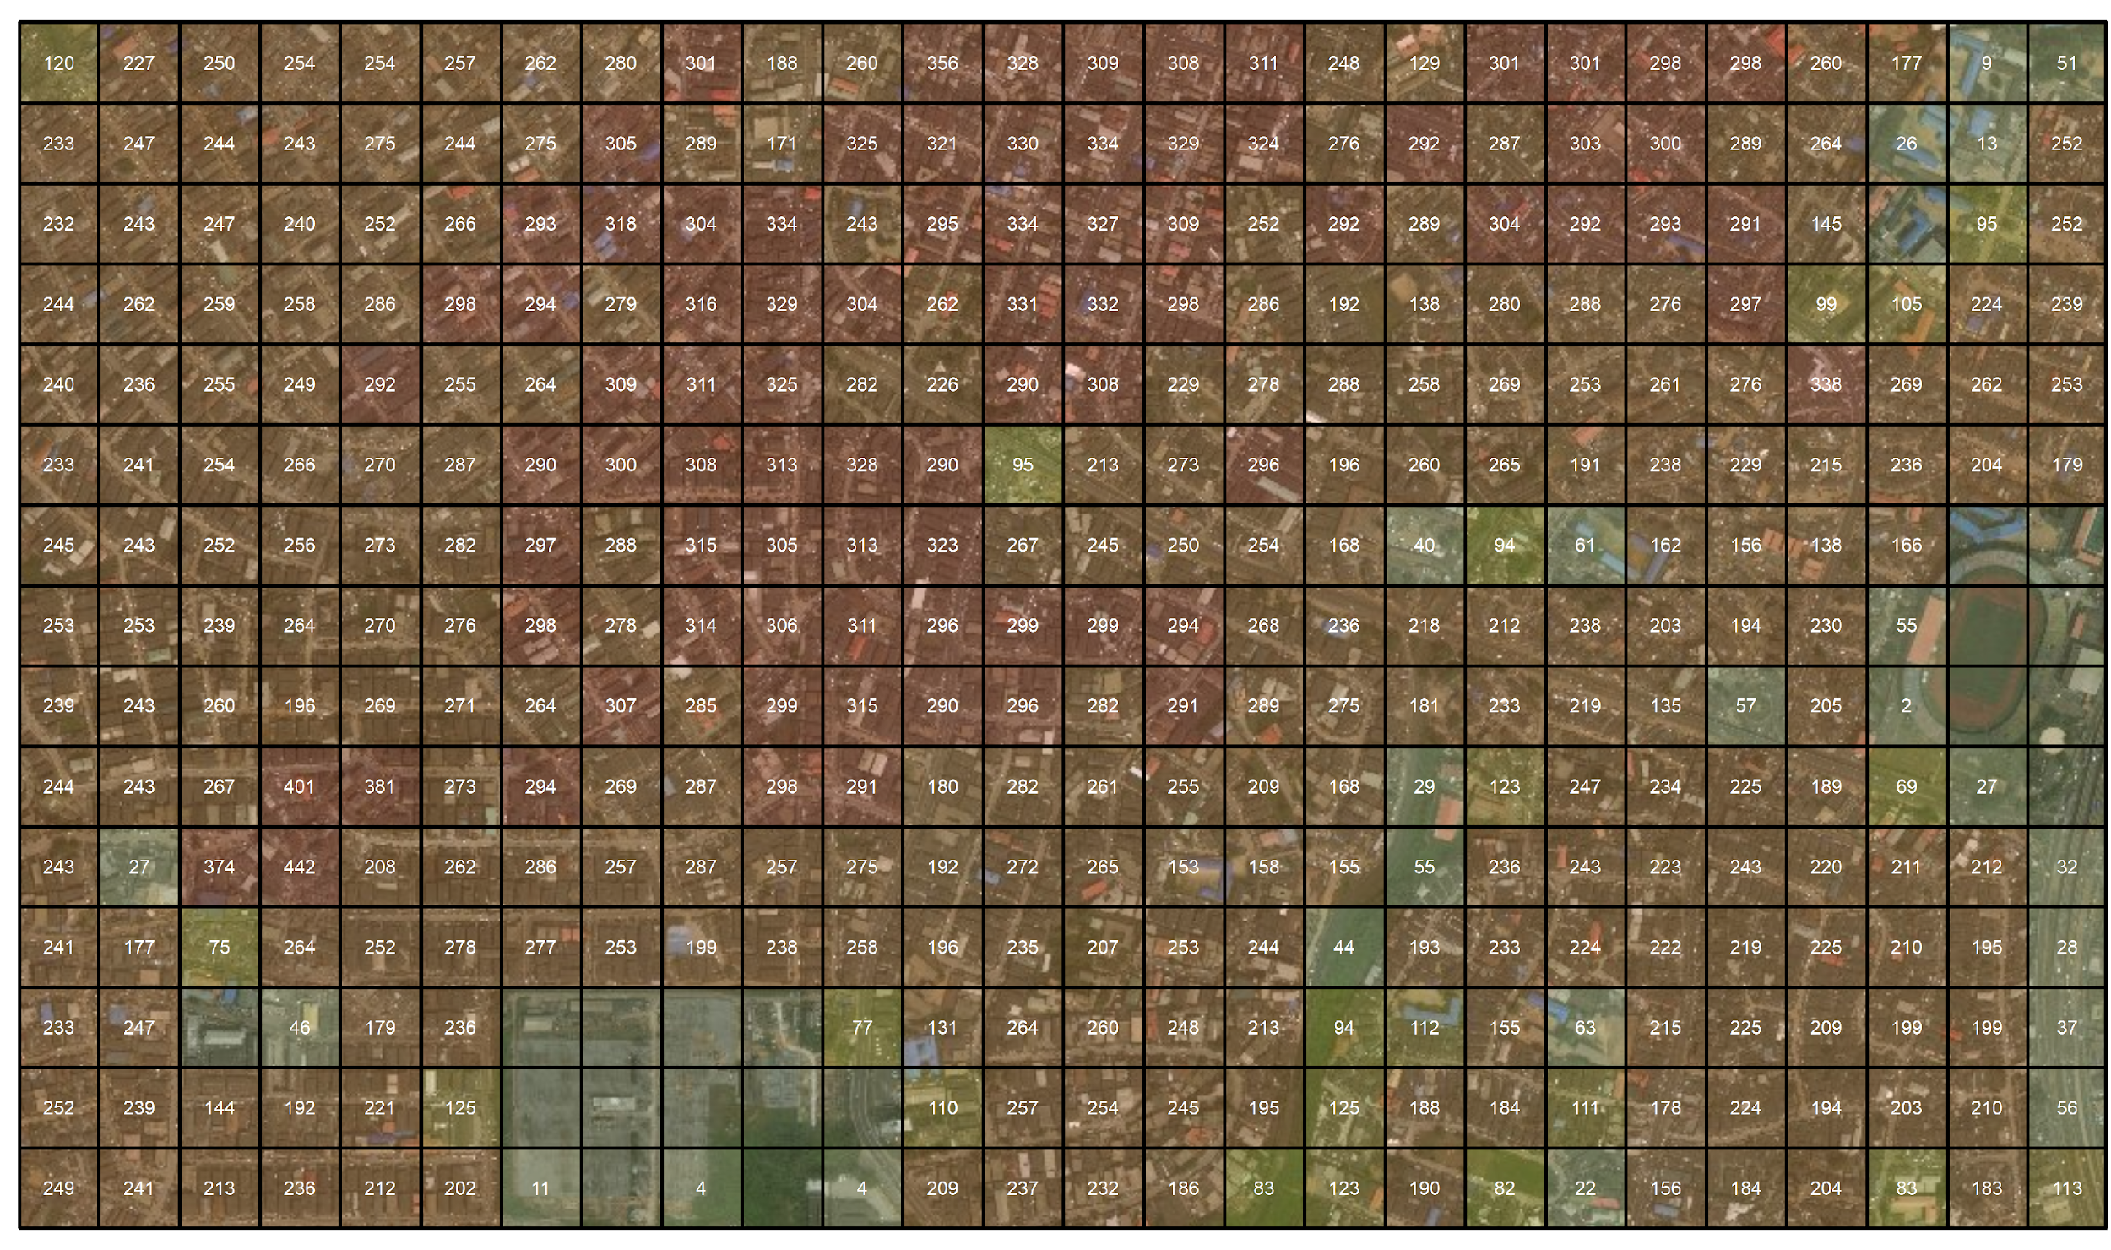
Gridded population estimates
Notes:
Gridded population data are estimates of the population in small regularly-shaped grid squares as small as a city block.
Overlay a grid on area of interest and you prediYou put a number of people per grid. You predict by grid cell (100x100) how many people are likely to be in that cell.

Slide 10
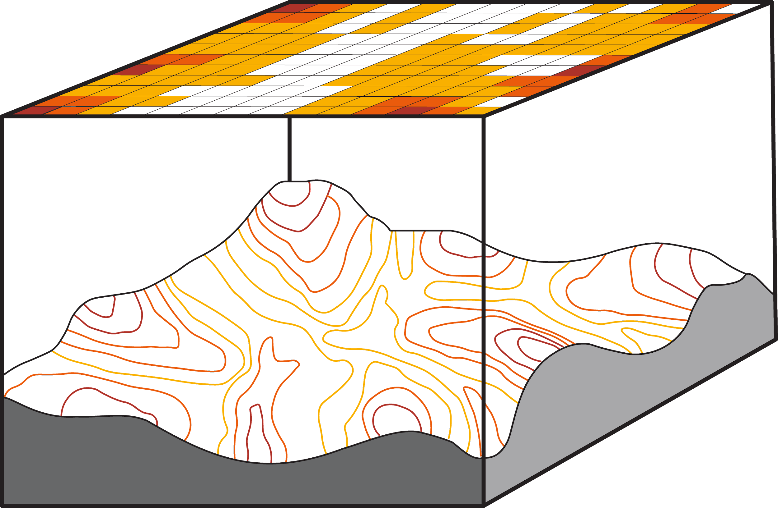
‘Raster’ spatial format
Gridded representation:
Set of grid cells
Uniform cell size and shape
One value per grid cell
Insight into spatial gridded data format
Notes:
Total time limit for section:
Gridded pop data are based on a traditional raster GIS data.
On the schema on the right, you can see geospatial variables are represented using grid cells. Each cell has the value of the underlying elevation of the landscape.
Every cell has the same size so are comparable.

Slide 11
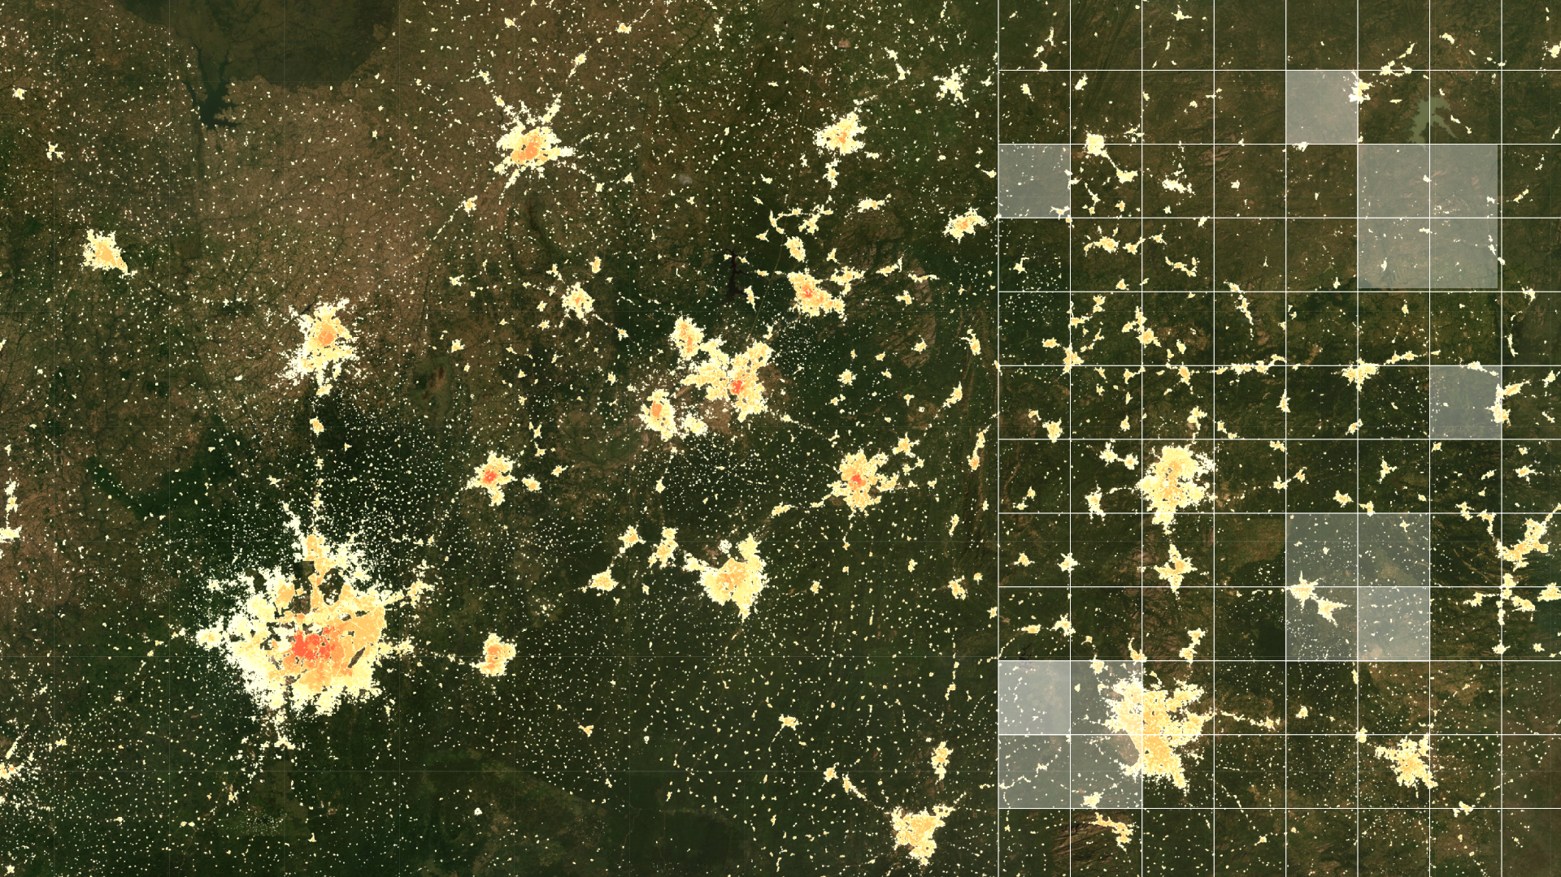
What are gridded population estimates?

Slide 12
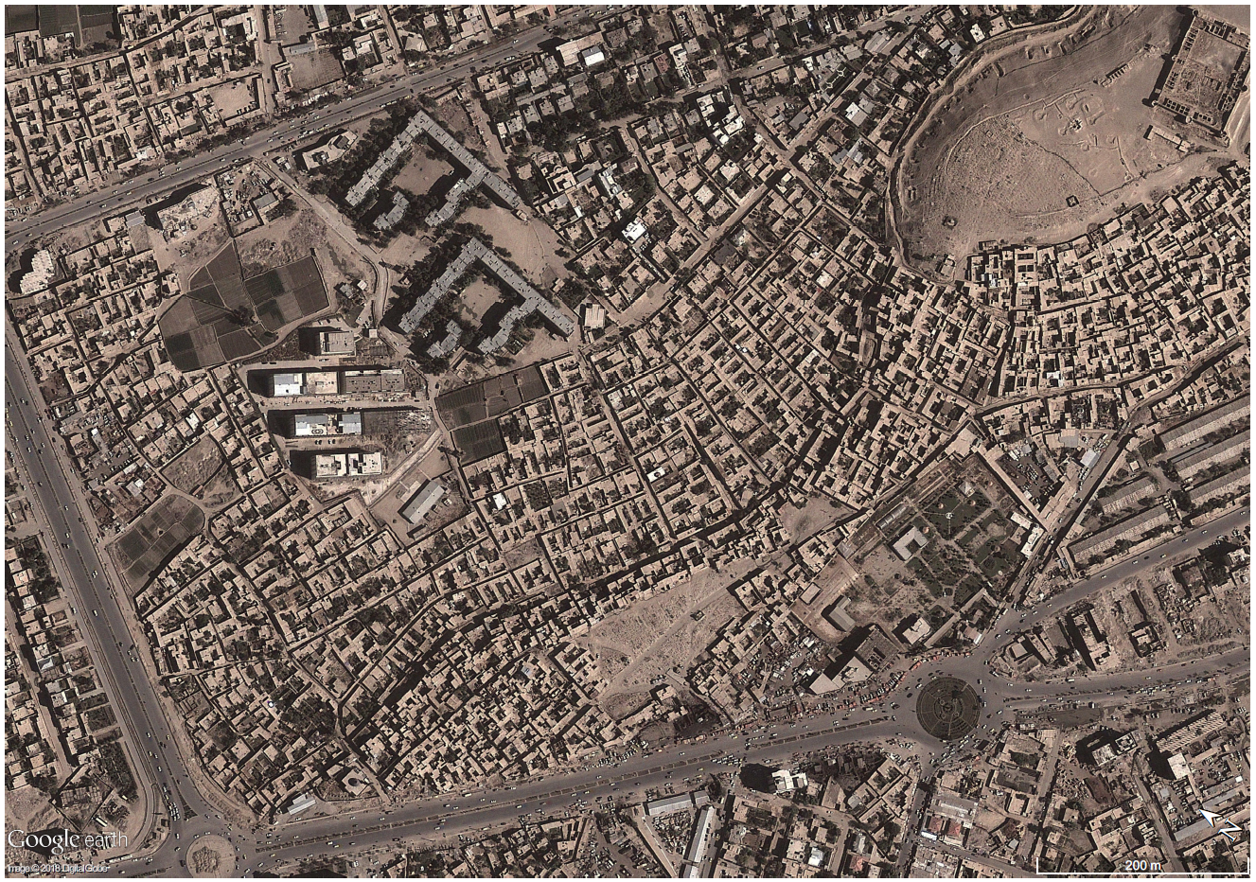


Slide 13
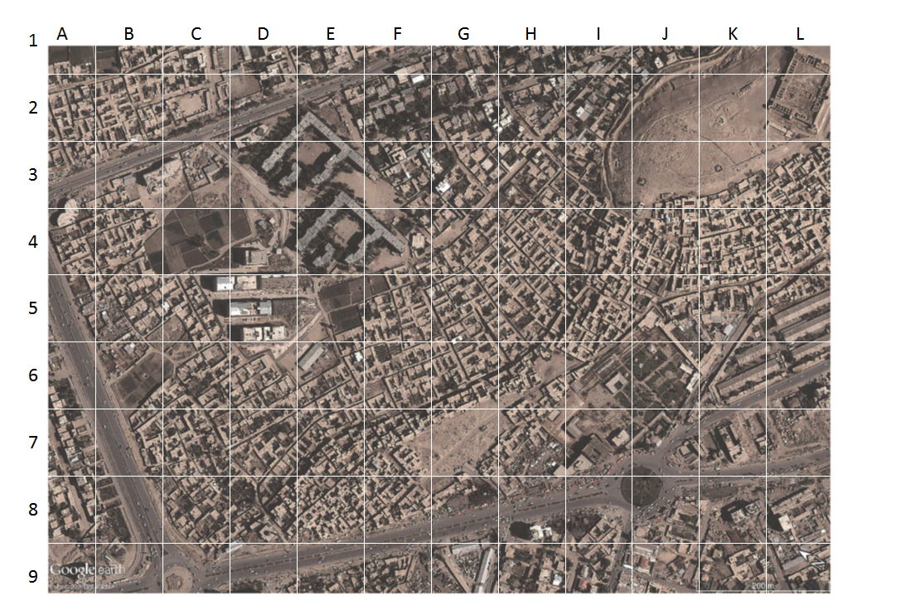

Slide 14
Which grid cells are not populated?
ⓘ Start presenting to display the poll results on this slide.

Slide 16
Which grid cells contain tall buildings?
ⓘ Start presenting to display the poll results on this slide.

Slide 17
No building
Tall buildings
Non-residential building?
Dense buildings

Slide 18
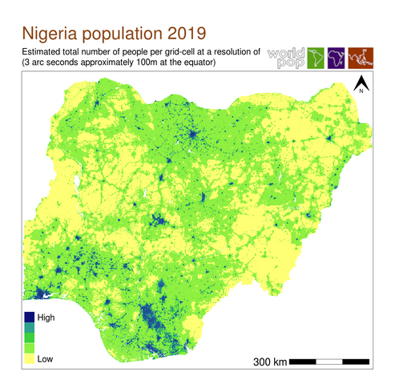

Low population density
High population density
Gridded population with national coverage

Slide 19
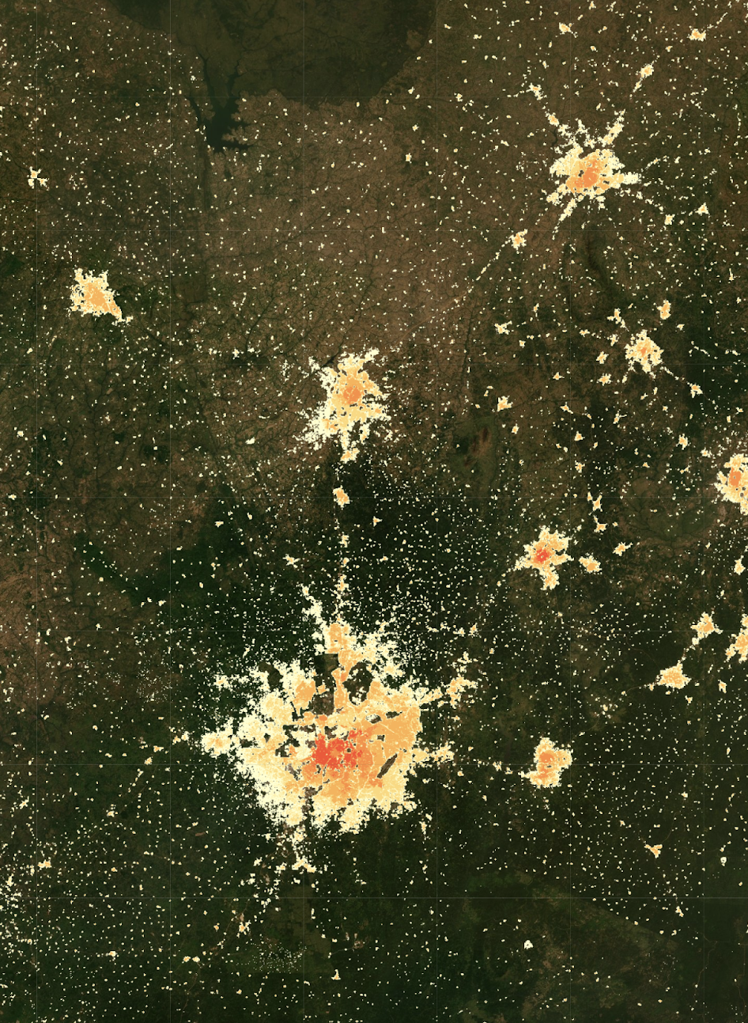
Enable easy comparison between areas
Fine understanding of population density variation
Great aggregation flexibility
Easily integration with ancillary dataset
Continuous surface leveraging power for any algorithm
Advantages of gridded population

Slide 20
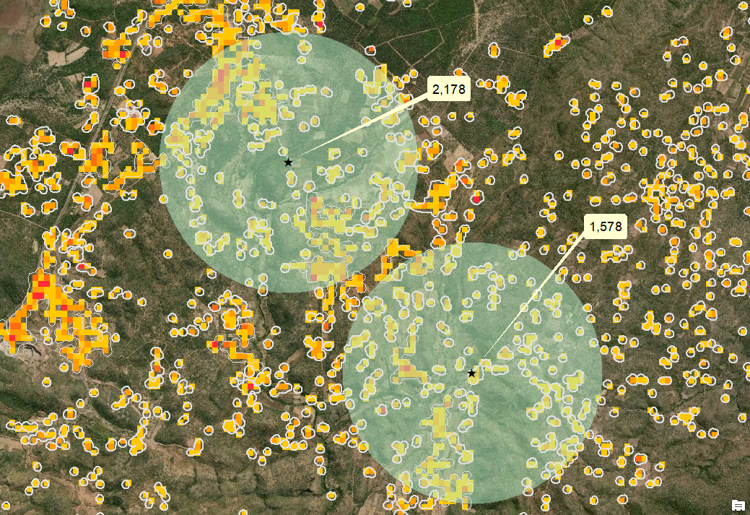
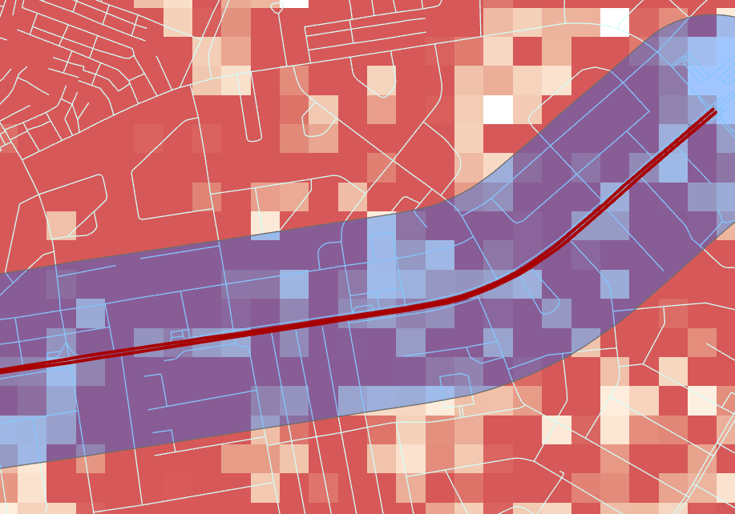
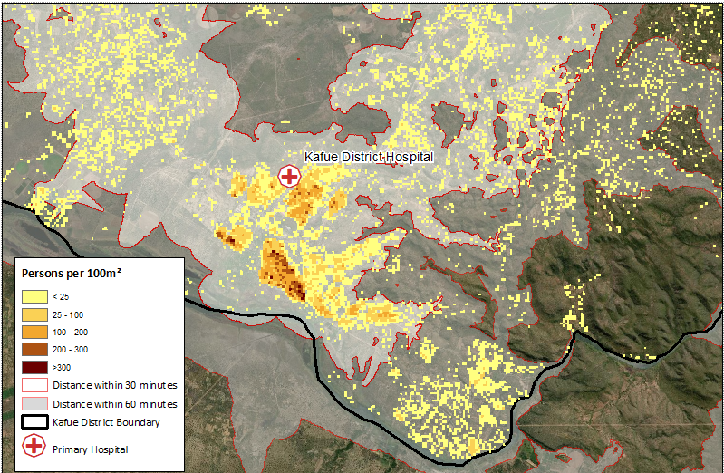
Value of high-resolution gridded population data
Around a point
(health facilities, school, earthquake, …)
Around a line
(rivers, roads, borders, …)
Custom area
(catchement area, health area,…)
Notes:
More precise and can leverage different types of analysis
E.g. computer catchment areas (which you cannot with province level data)
Example of the river which cuts a province in half. If we want to determine how many people would be affected by a flood, gridded population data provide estimates at a finer scale (100x100m)

Slide 21
Modelling gridded population
How to use Gridded population

Slide 22
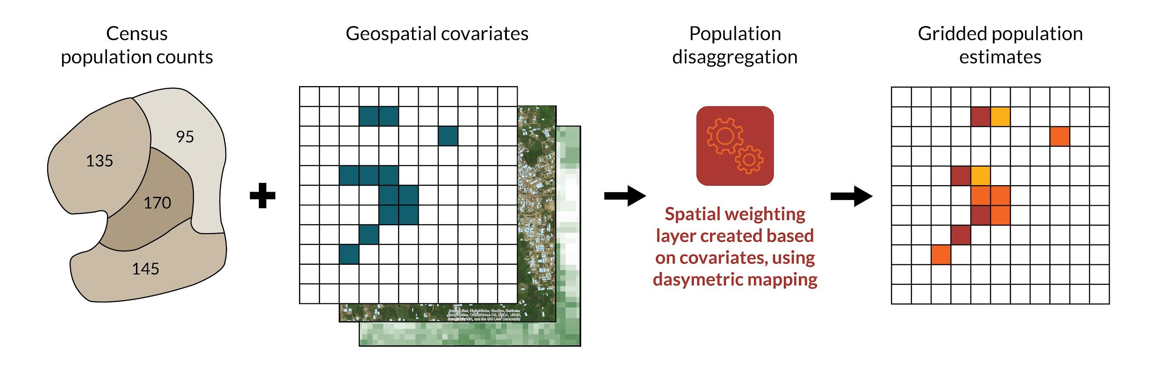
First approach Disaggregating administrative totals Tutorial: https://github.com/wpgp/top-down-tutorial
Top-down modelling

Slide 23
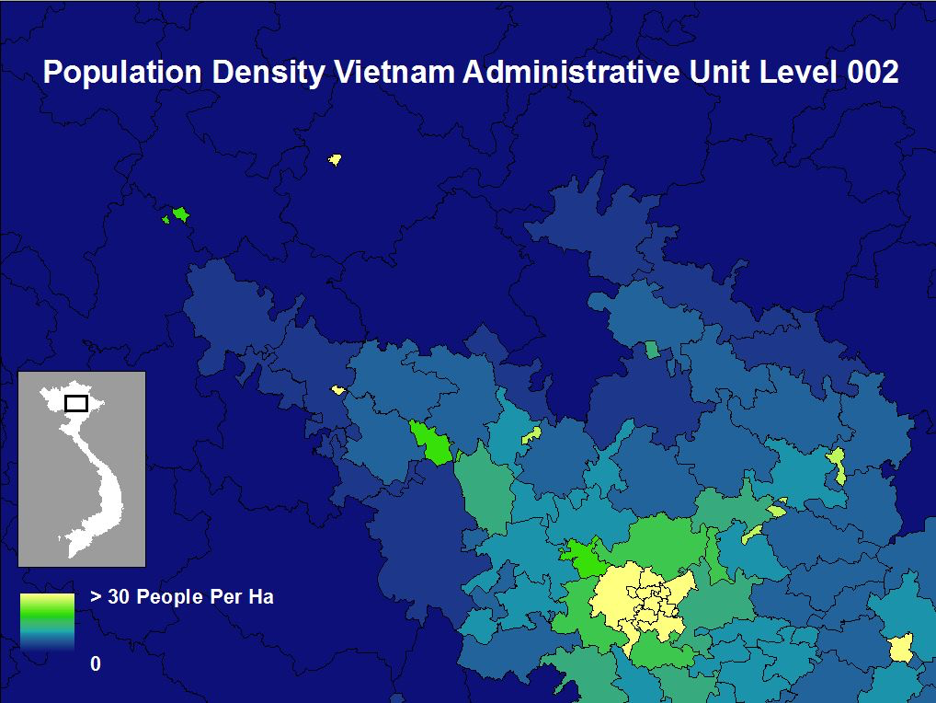
Example [1|4]
-Population density in Vietnam
-Administrative totals-

Slide 24
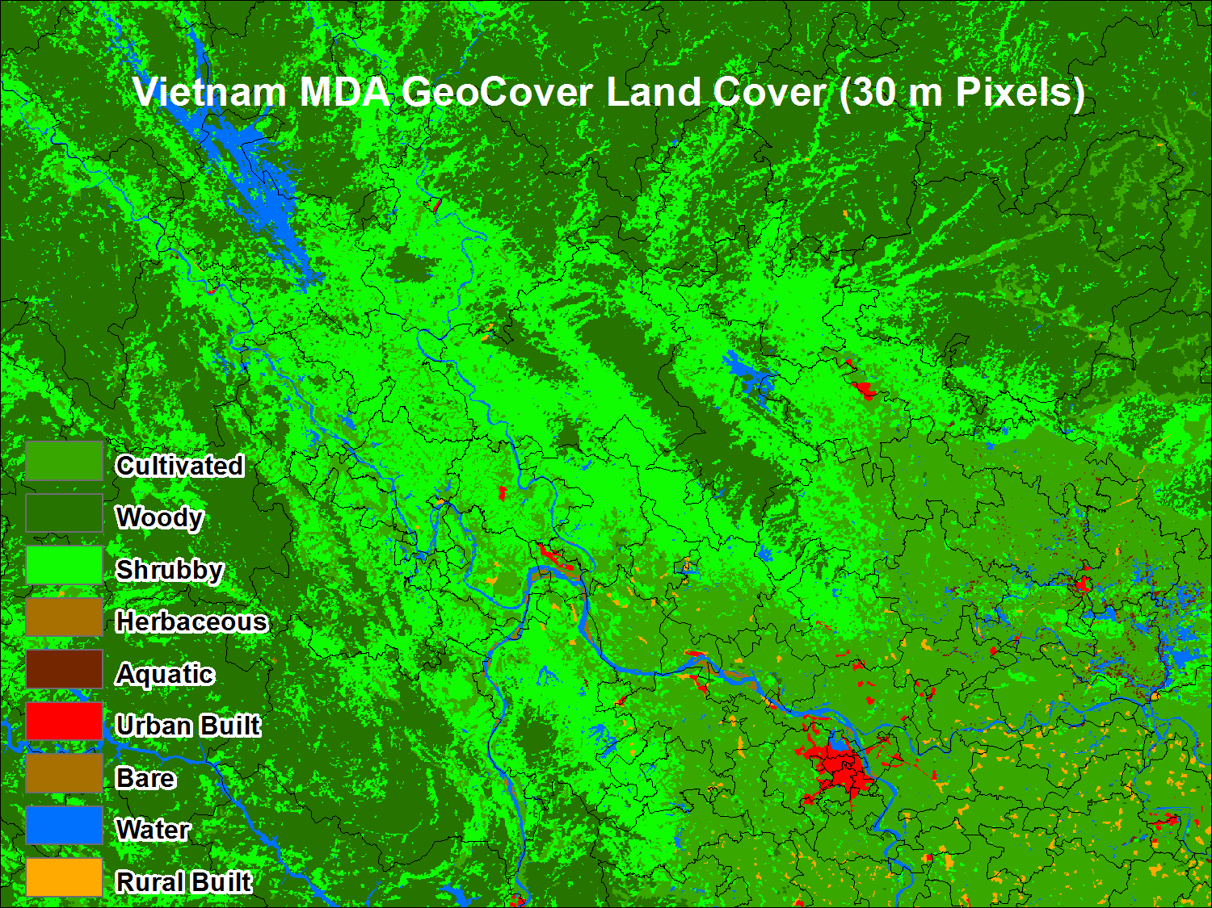
Example [2|4]
-Landcover in Vietnam
-MDA global land cover (100m)-

Slide 25
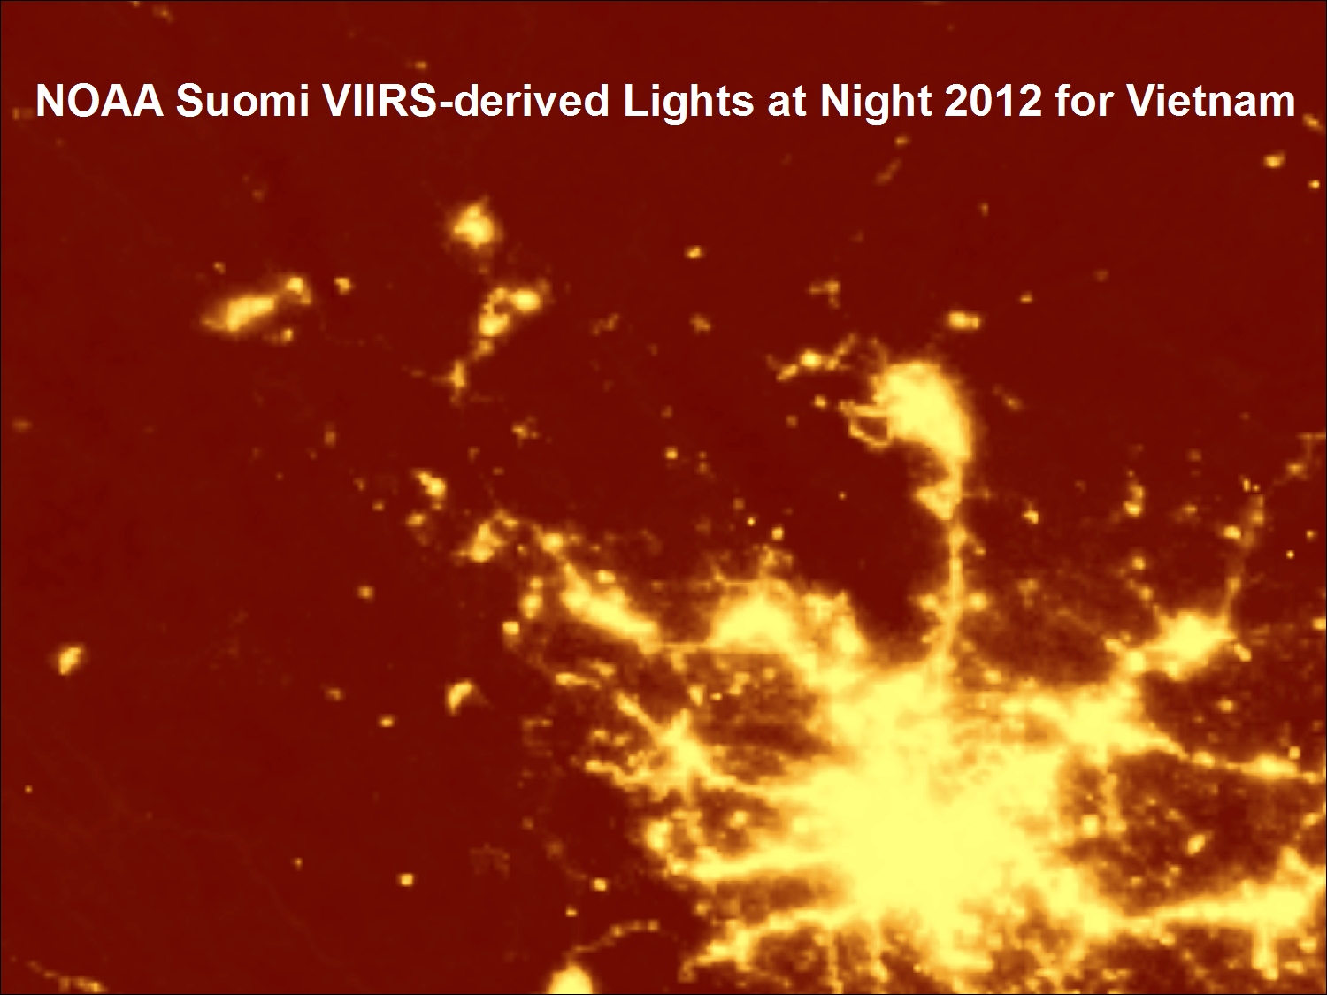
Example [3|4]
-Nightlight in Vietnam-
-NOAA-Suomi VIIRS-derived (100m)-

Slide 26
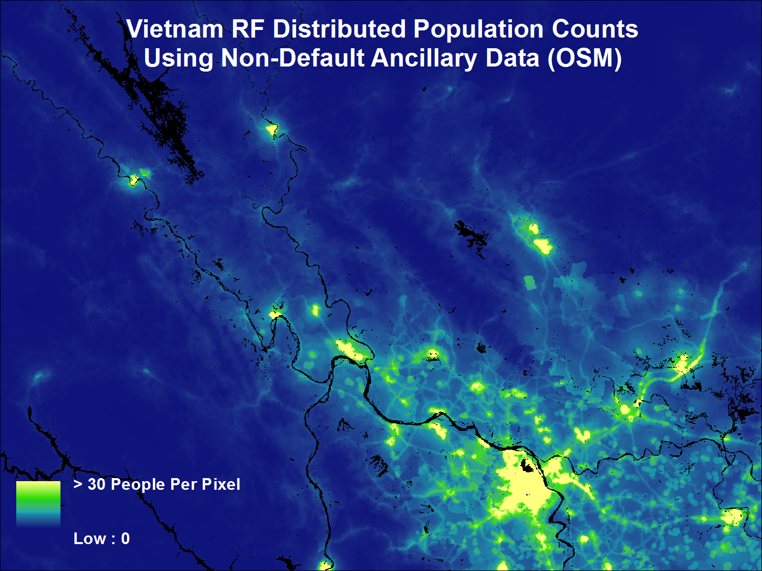
Example [4|4]
-Population count inVietnam-
-100m pixel-

Slide 27
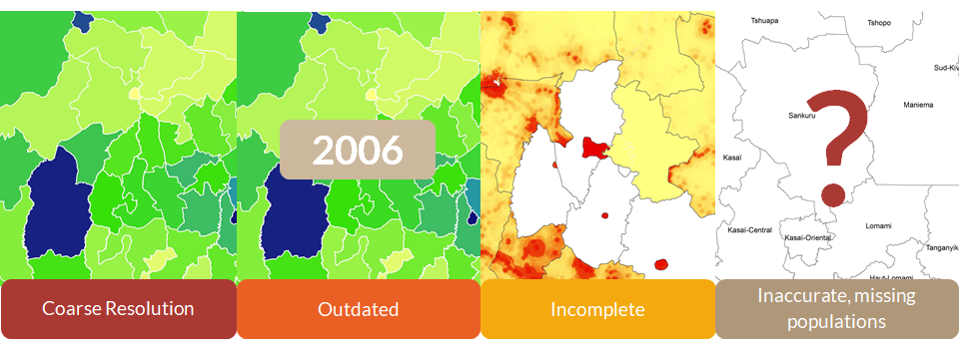
Limits of available population data

Slide 28
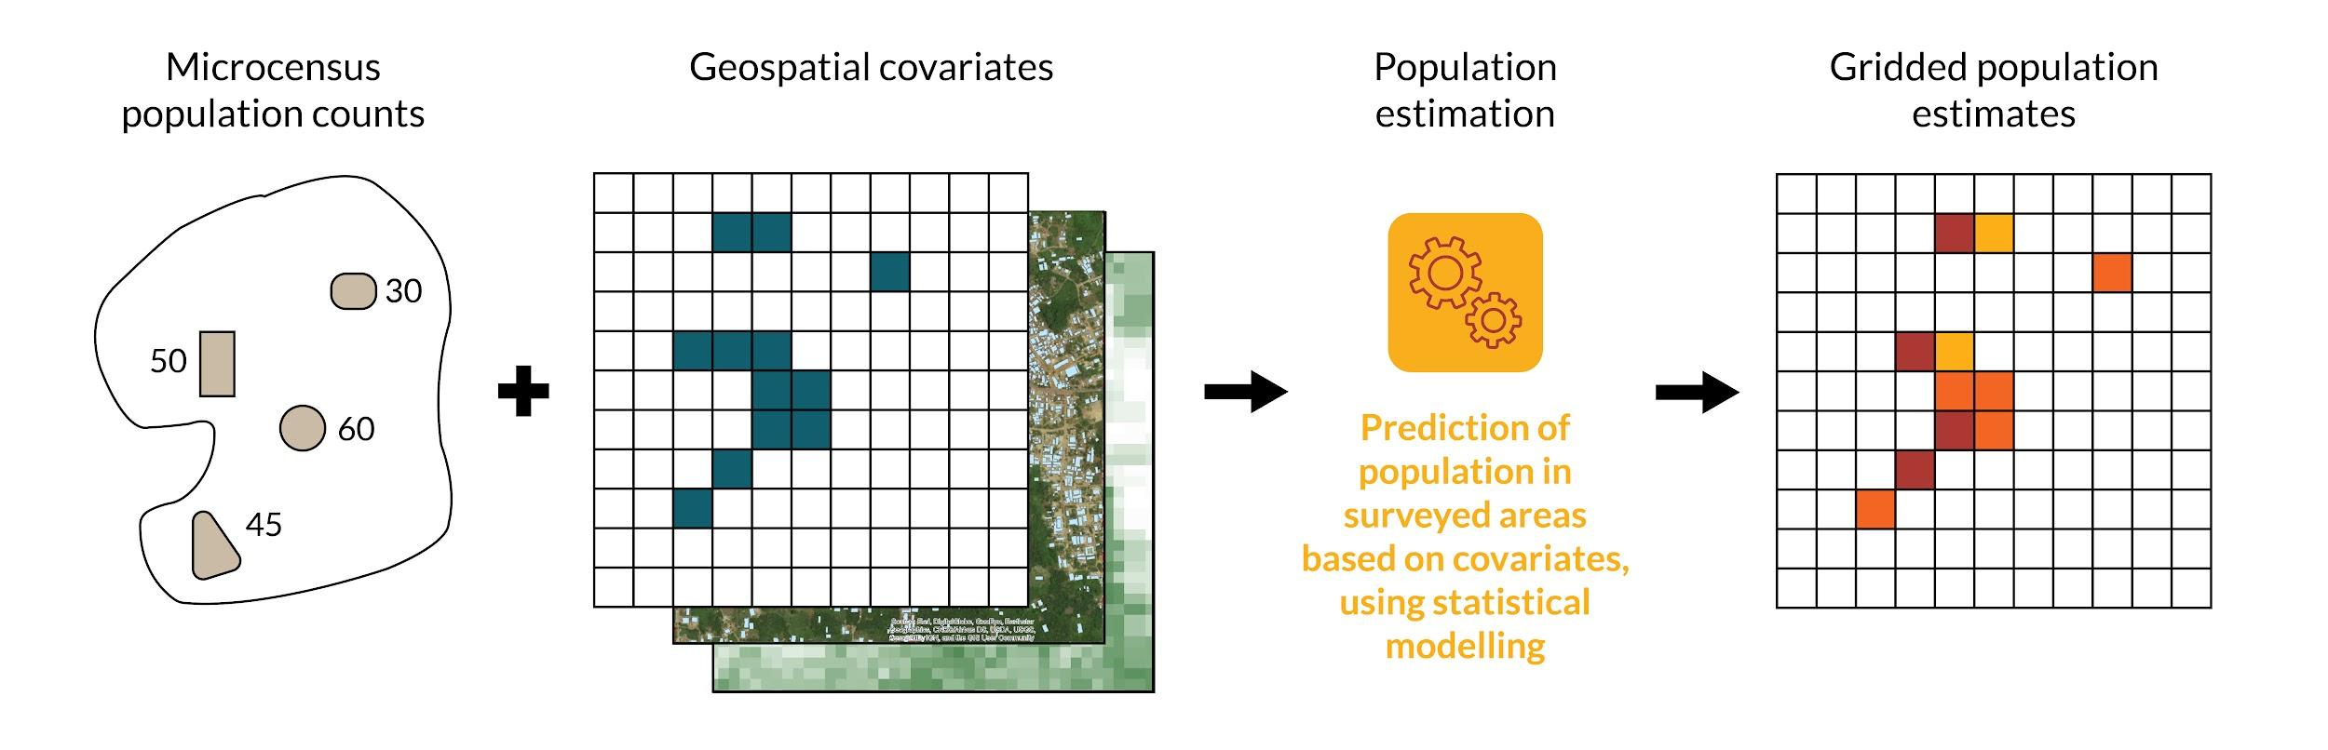
Second approach: Predicting population Tutorial: https://wpgp.github.io/bottom-up-tutorial/
Bottom-up modelling

Slide 29
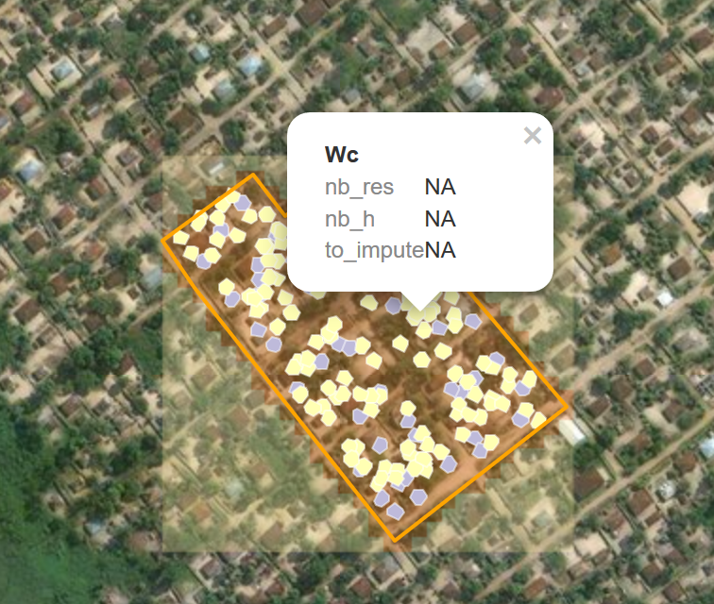
Generic aspect
Total enumeration of a well-defined geographical area
One cluster = 3 hectares of settled area
Three levels:
Housing unit, building, cluster
Notes:
To dvp the modelling in some countries, we’ve been doing some surveys that we call microcensus - this is what it can look like
Microcensuses are… {def from slide}

Slide 30

Data sources:
Admin totals
Partial census
Microcensus
Pre-survey household listing
Population data
Notes:
Different data sources can be used incl (list)
You don’t need to combine all of the data sources - these are examples of what we can use, depending on the availability of the data in the country we are doing the modelling for
Microcensus is for pop modelling purposes only -data gathered for pop modelling
Pre-survey household listing is about repurposing the data collected for another study

Slide 31
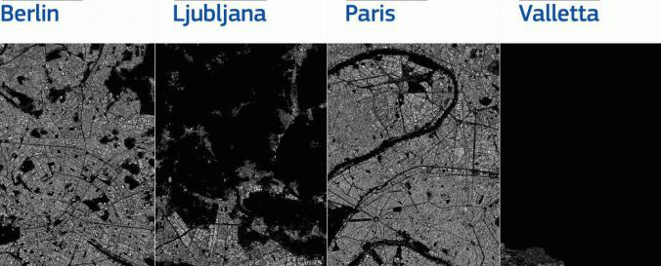
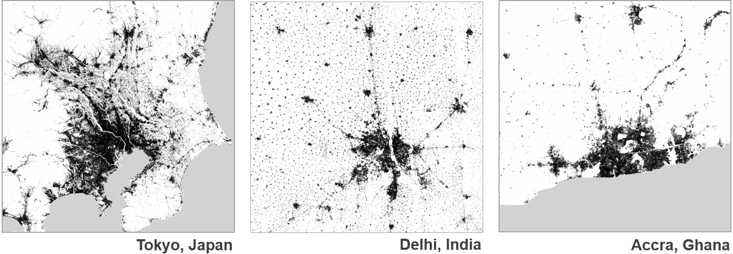

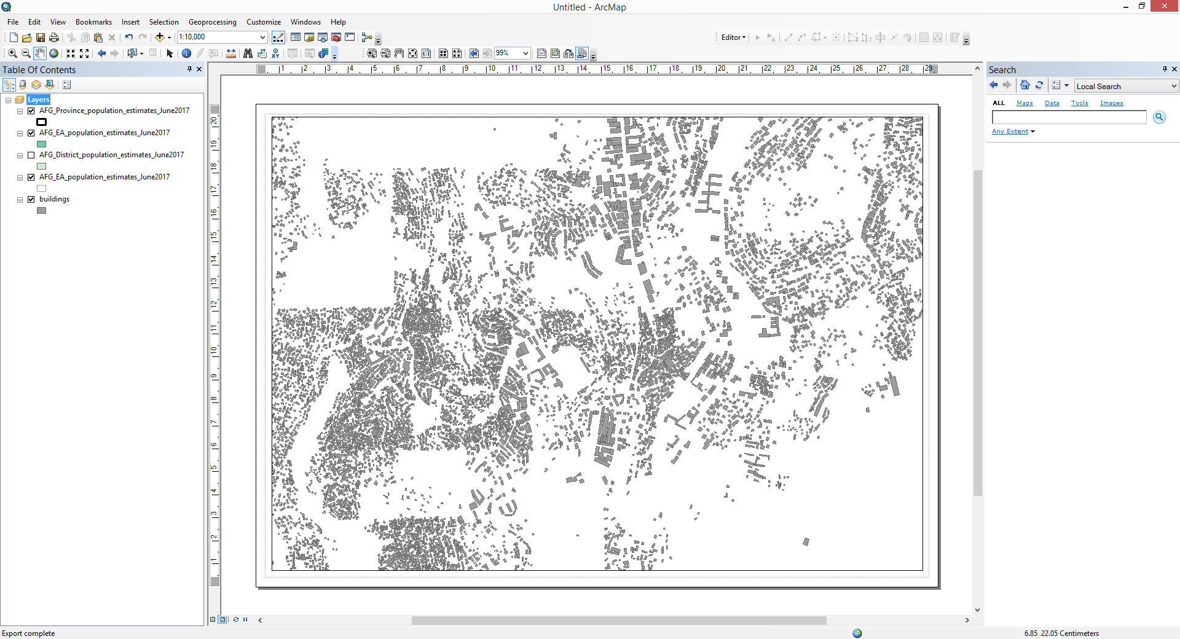
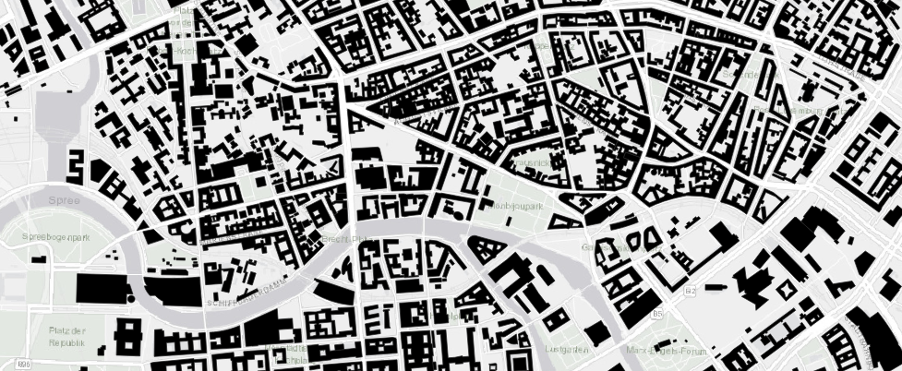
Global Human Settlement Layer
Global Human Footprint
Berlin
Liubliana
Paris
Tokyo
Delhi
Accra
ORNL Settlement
Ecopia Building Footprints Powered by Maxar
Settlement layers
Notes:
Settlement layers are a representation of the build-up areas in a country. They are several ways of retrieving them.
More often, it is by extracting features from satellite imagery
Different organisations have provided GRID3 with these datasets.
Settlement datasets are crucial are the main proxy for human population. It’s the main source of information of where populations are located.
For more information about settlement, please check our webinar??

Slide 32
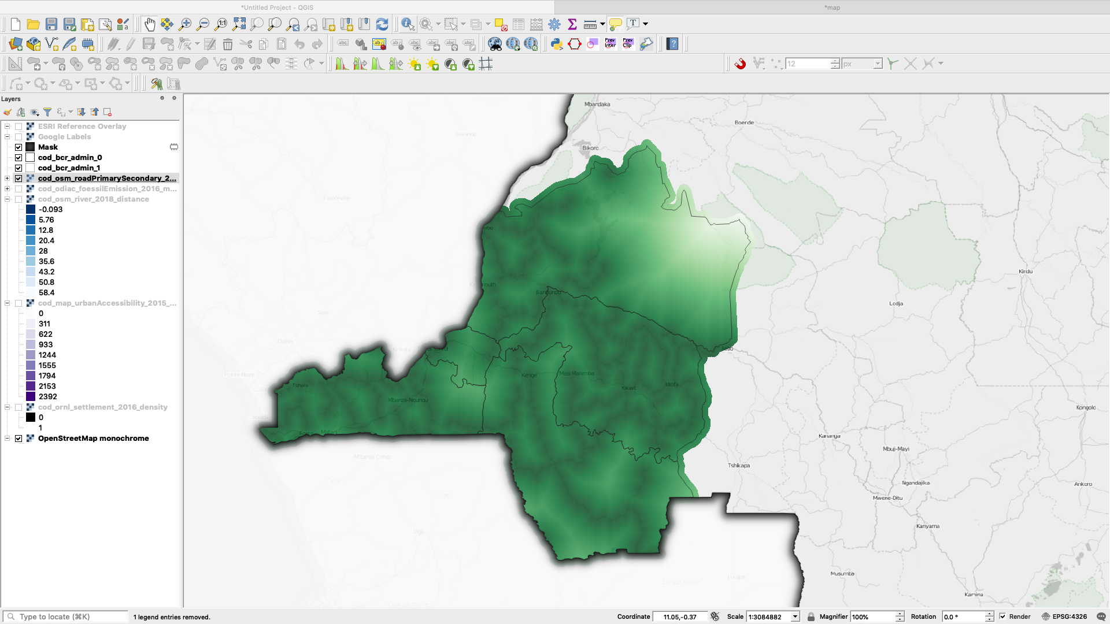
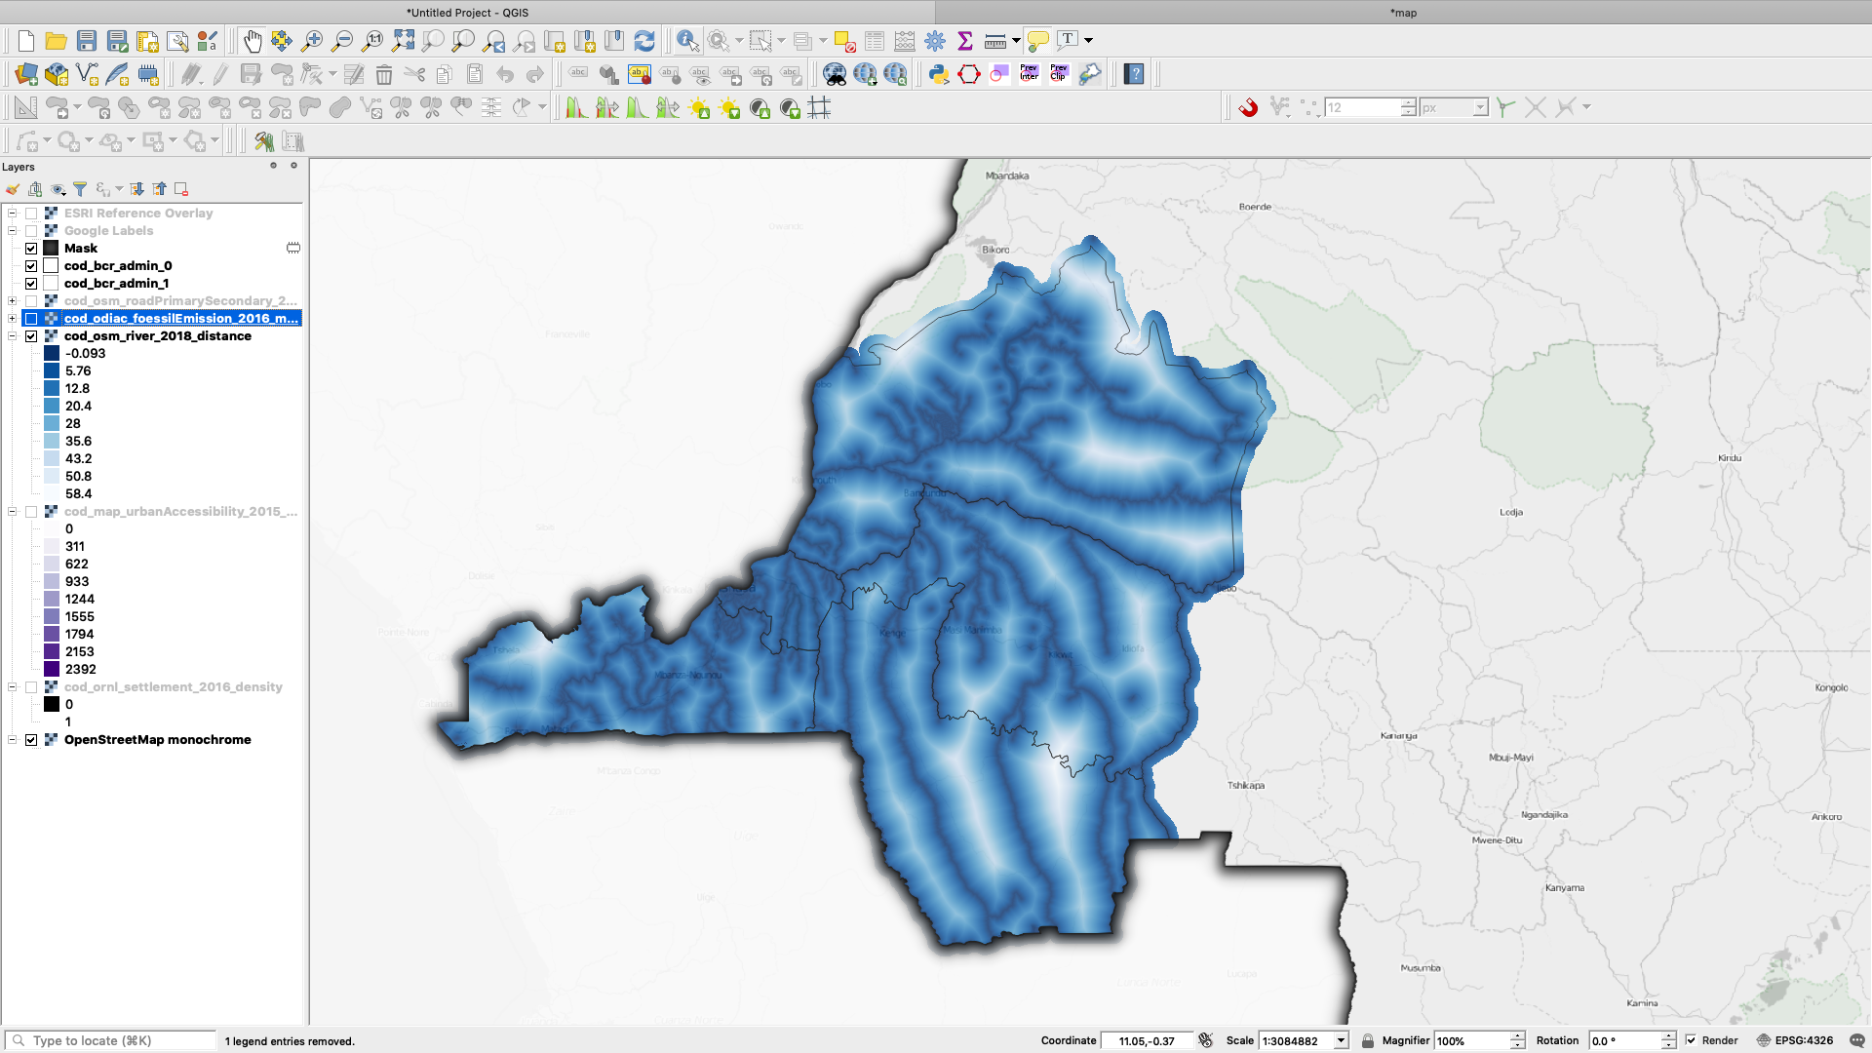
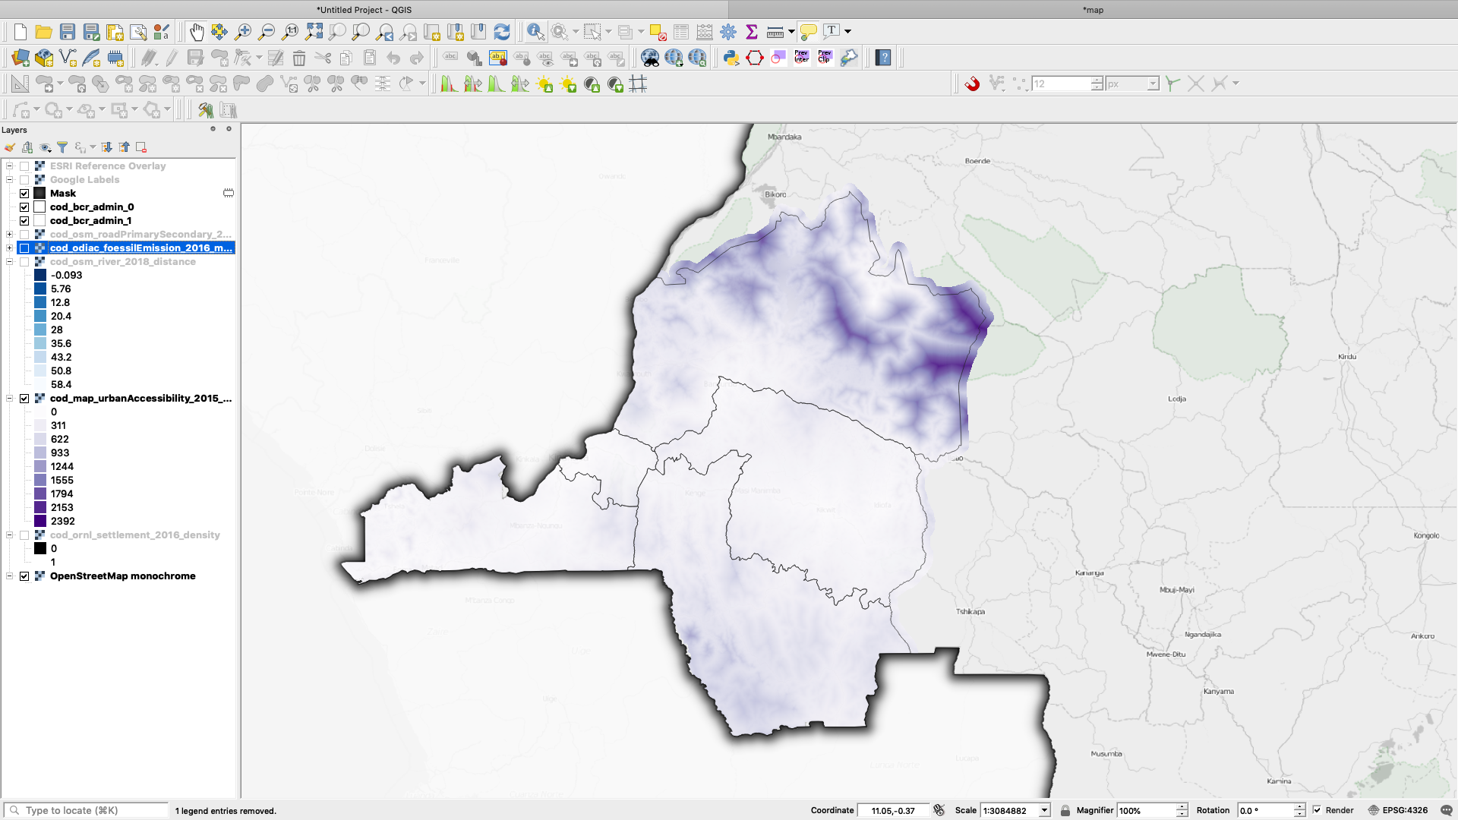
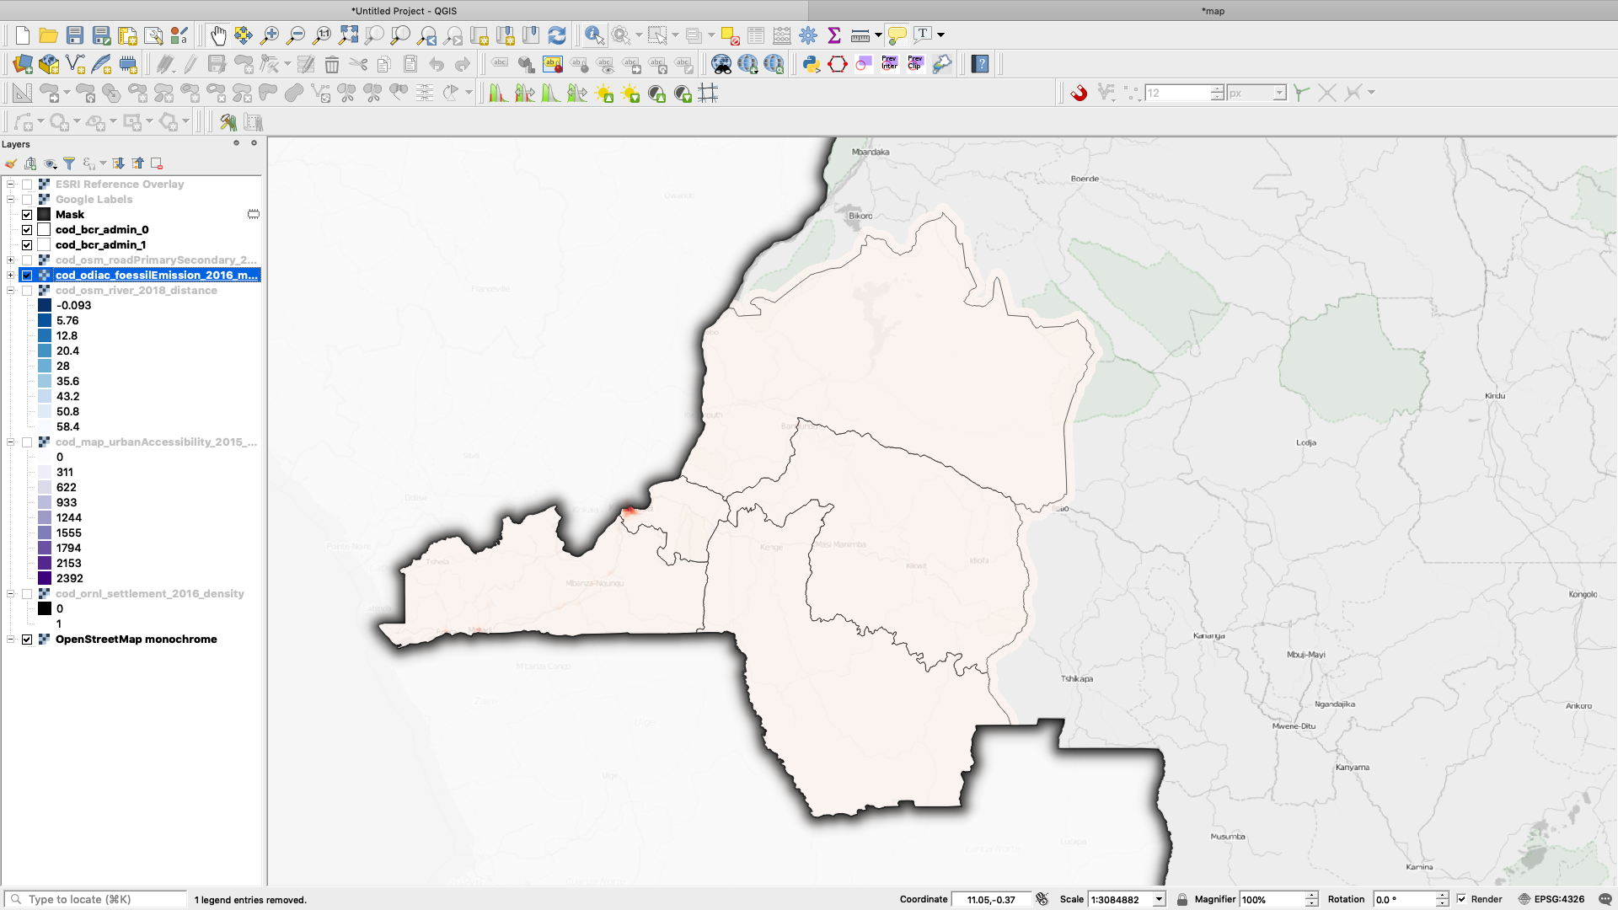
Distance to primary and secondary roads
Distance to rivers
Urban accessibility
Average fossil fuel emission
Urban accessibility
Distance to primary and secondary roads
Average fossil fuel emission
Geospatial covariates
Notes:
Geospatial covariates should provide different insights on the location of populations. Some are related to physical contexts such as distance to roads or rivers. Others to the socioeco context such as urban accessibility.
Physical Context
Socio-economic Context
Political or Administrative Context - can be represented by administrative boundaries.

Slide 33
Modelling logic

Slide 34
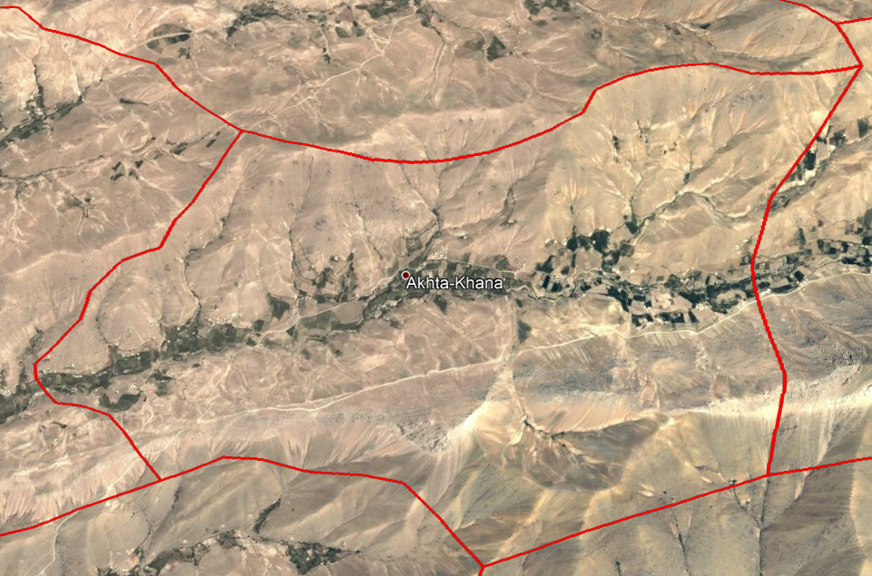
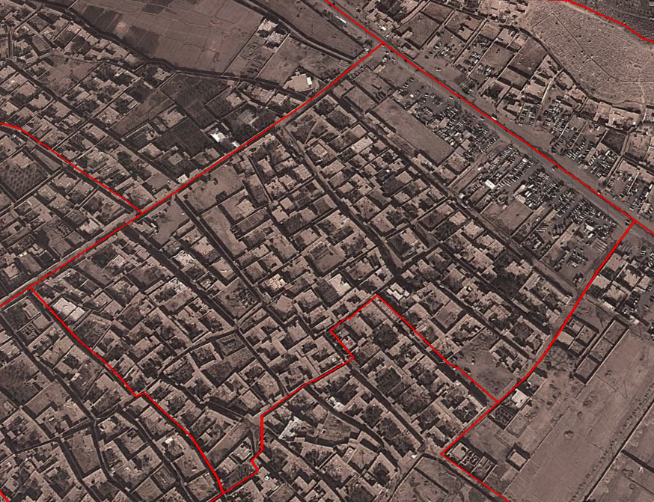

Cluster 1
Cluster 2
C2
Population Size
Population size| 1,000 people
Settlement density | high
Population size | 500 people
Settlement density| low
C1
Settlement Density
Relationship to population

Slide 35
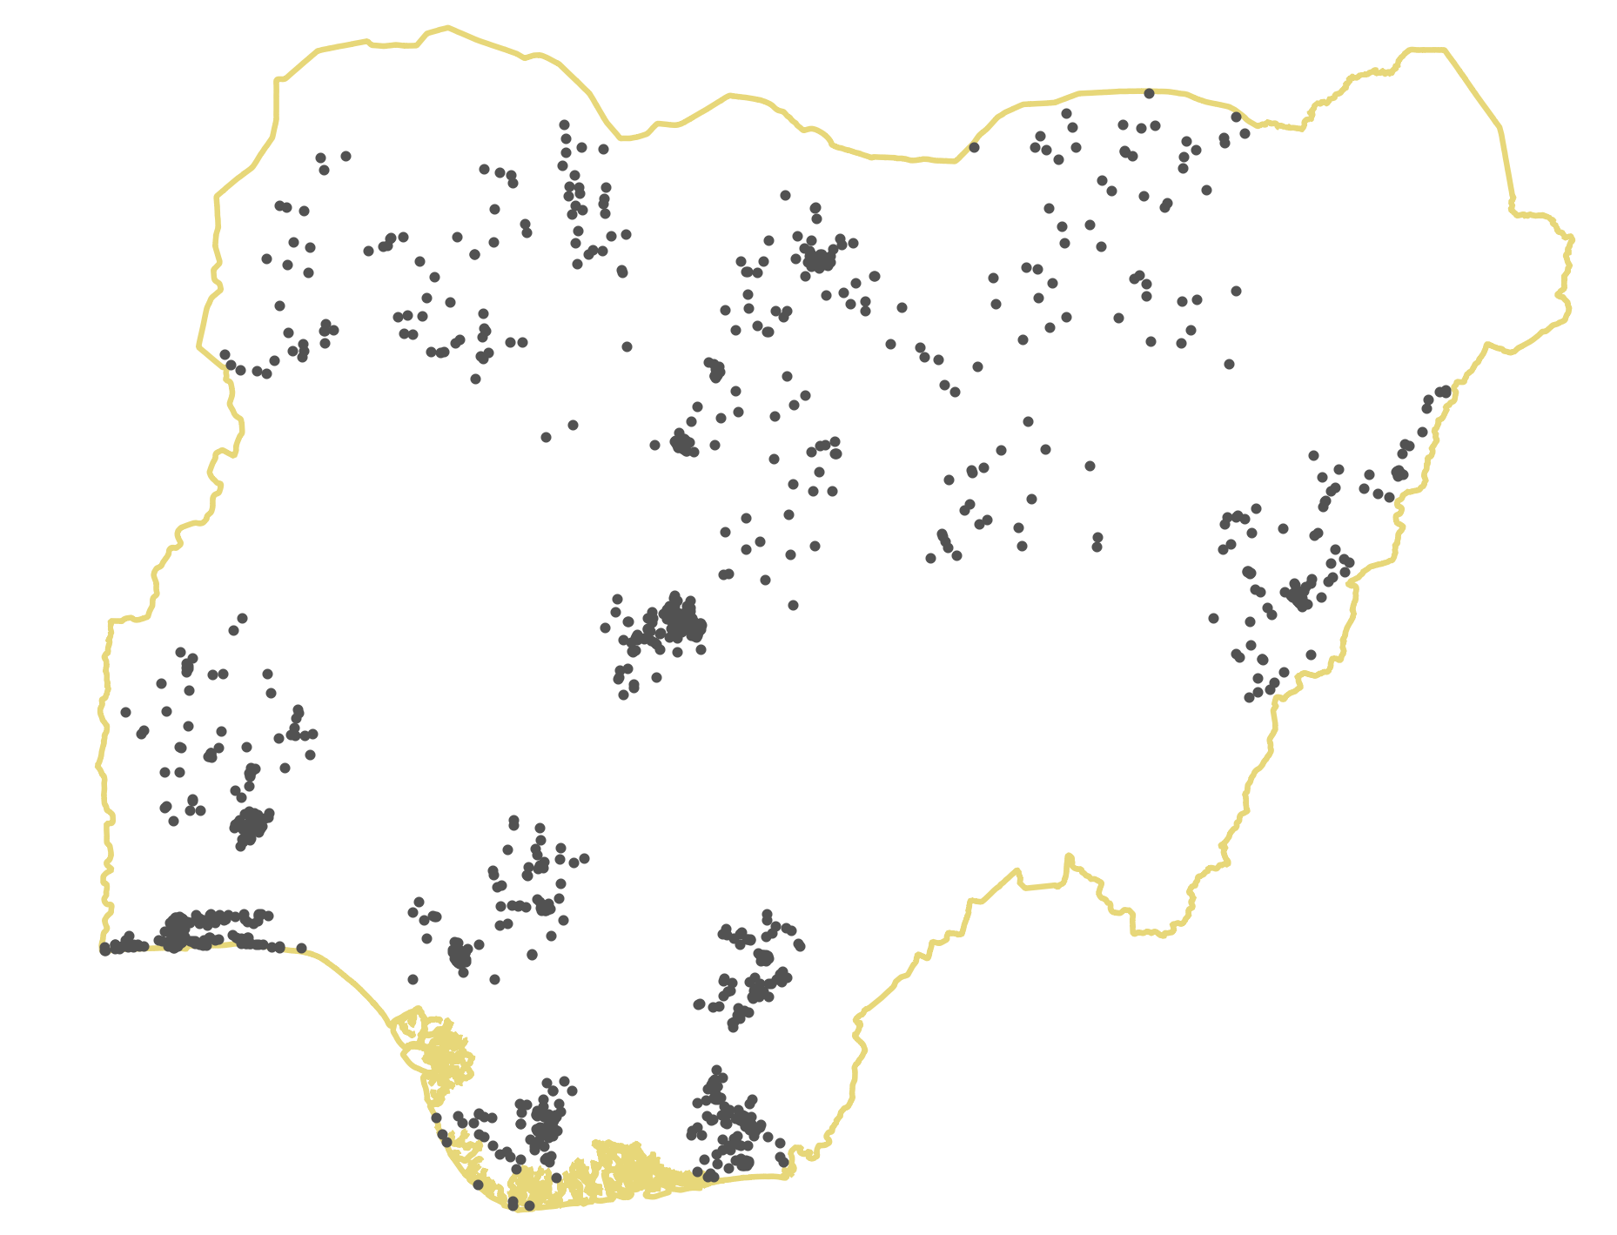
Prediction in unsurveyed area
Uncertainty
Population size
Settlement layer
Relationship to population

Slide 36
Cluster 1
Cluster 2
Settlement density | low
Settlement density | high
Mean slope | high
Mean slope | low
Nightlights | low
Nightlights | high
Distance to urban center | high
Distance to urban center | low
Relationship to population

Slide 37
Bayesian modelling

Slide 38
Bayesian framework
Stochastic = what is random and thus unknown
Linked to:
Impossibility to know all relevant predictors
Errors in data collection
Imperfect representativity of the sample
Individual variation
Deterministic
Model
Ni = Di x Ai
Stochastic Model
Ni ~ Poisson(Di x Ai)
Advantages of Statistical Modelling

Slide 39
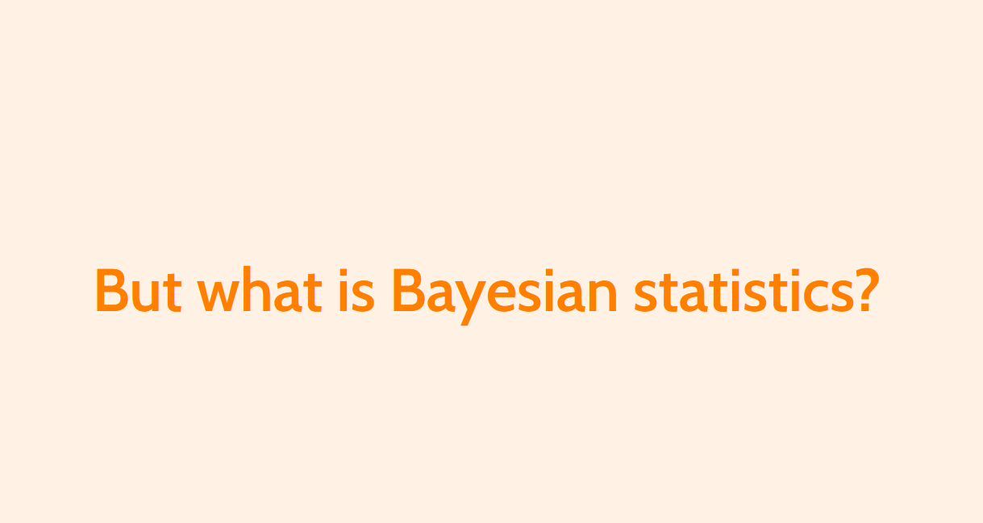
Learn more about it
Tutorial: https://wpgp.github.io/bottom-up-tutorial/
Bibliography:
Bayes Rules! An Introduction to Bayesian Modeling with R by Alicia A. Johnson, Miles Ott, Mine Dogucu
An Introduction to Bayesian Data Analysis for Cognitive Science by Bruno Nicenboim, Daniel Schad, and Shravan Vasishth
Bayesian Data Analysis, by Andrew Gelman, John Carlin, Hal Stern, Donald Rubin, David Dunson, and Aki Vehtari
Bayesian Data Analysis course, by Aki Vehtari
Bayesian workflow, by Andrew Gelman et al
Betancourt's blog: https://betanalpha.github.io/writing/

Slide 40
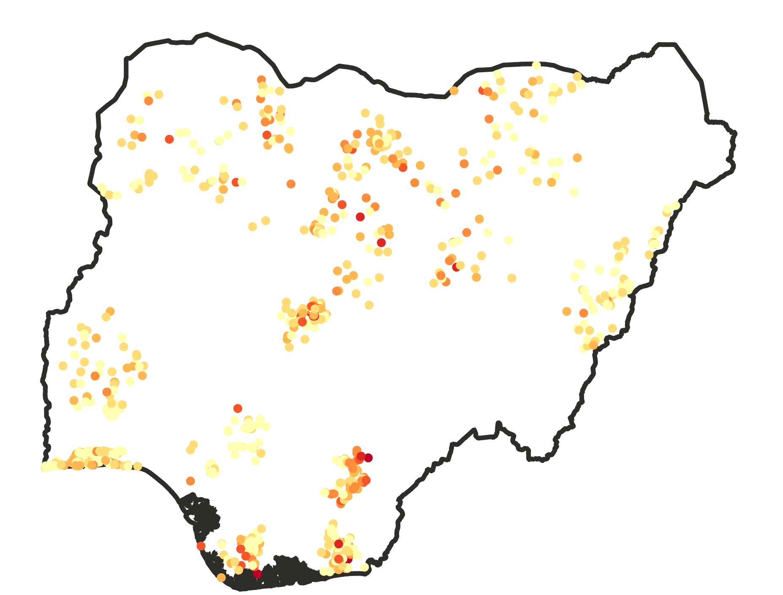
Hierarchical Framework
Population density variation occurs at different level that can be summarise within a hierarchical framework
Population distribution across sites
Advantages of Statistical Modelling

Slide 41
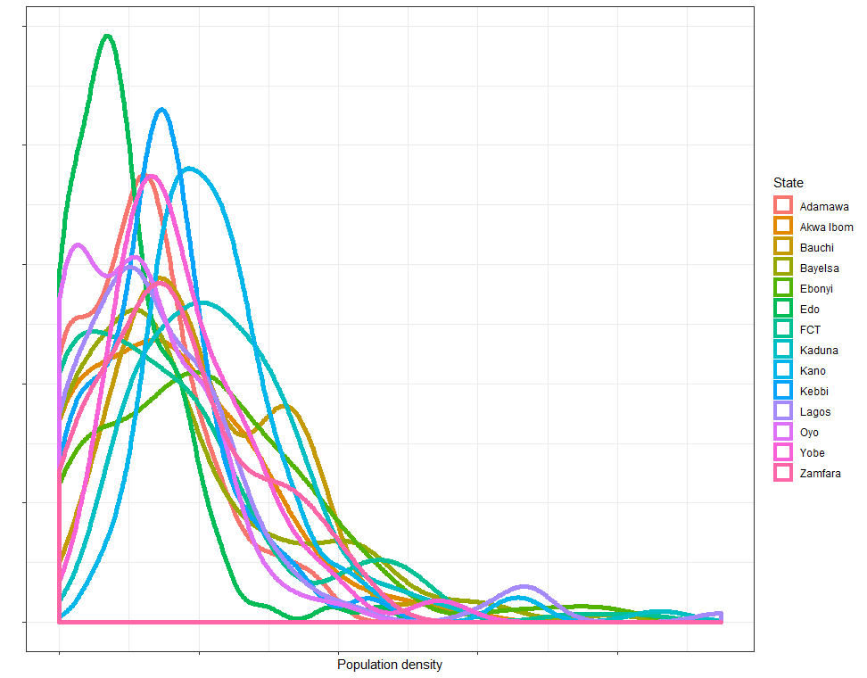
State level
Edo
Kano
Lagos
Hierarchical Setting

Slide 42
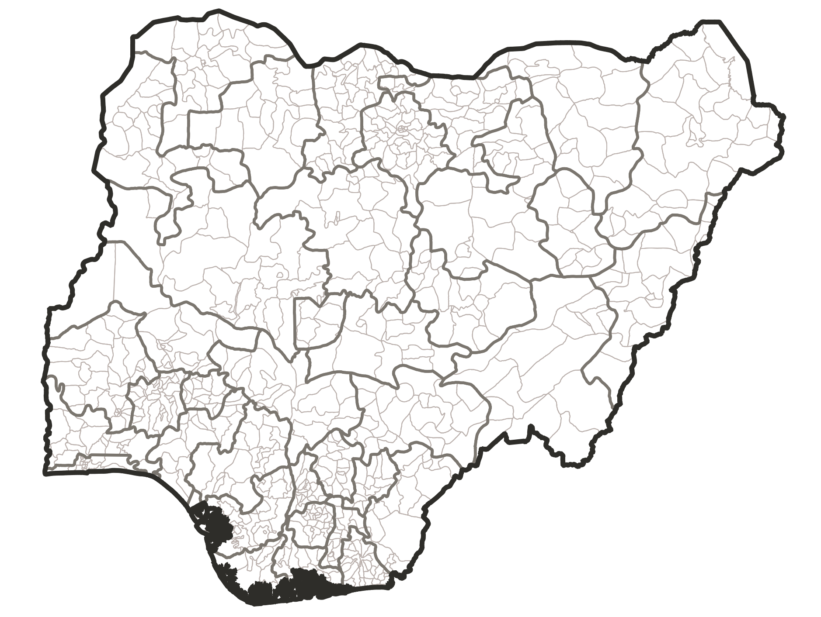
Local Government Area
Nearer density
Nearer density
Nearer density
Hierarchical Setting

Slide 43
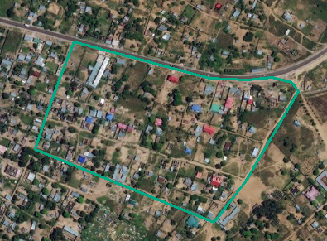
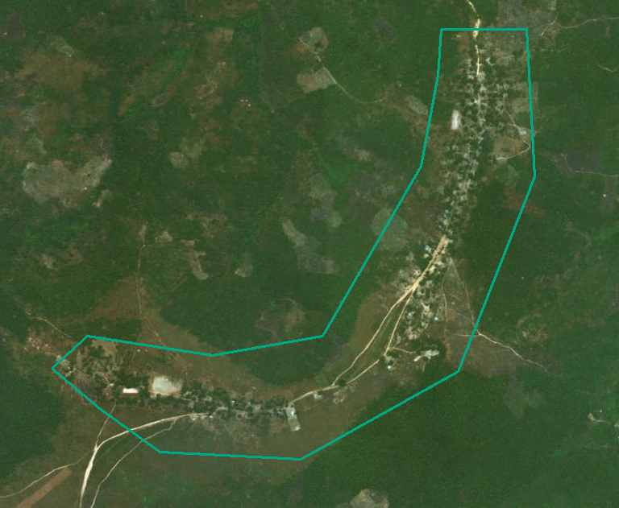
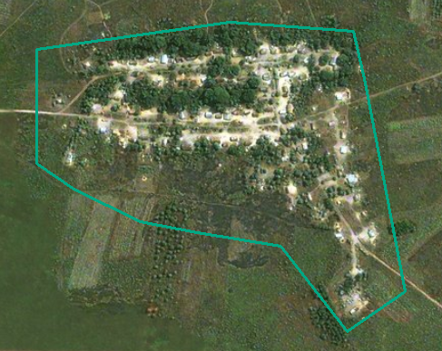
Settlement type
Urban
Rural
Village
Hierarchical Setting

Slide 44
Data access
Where to find the data

Slide 45
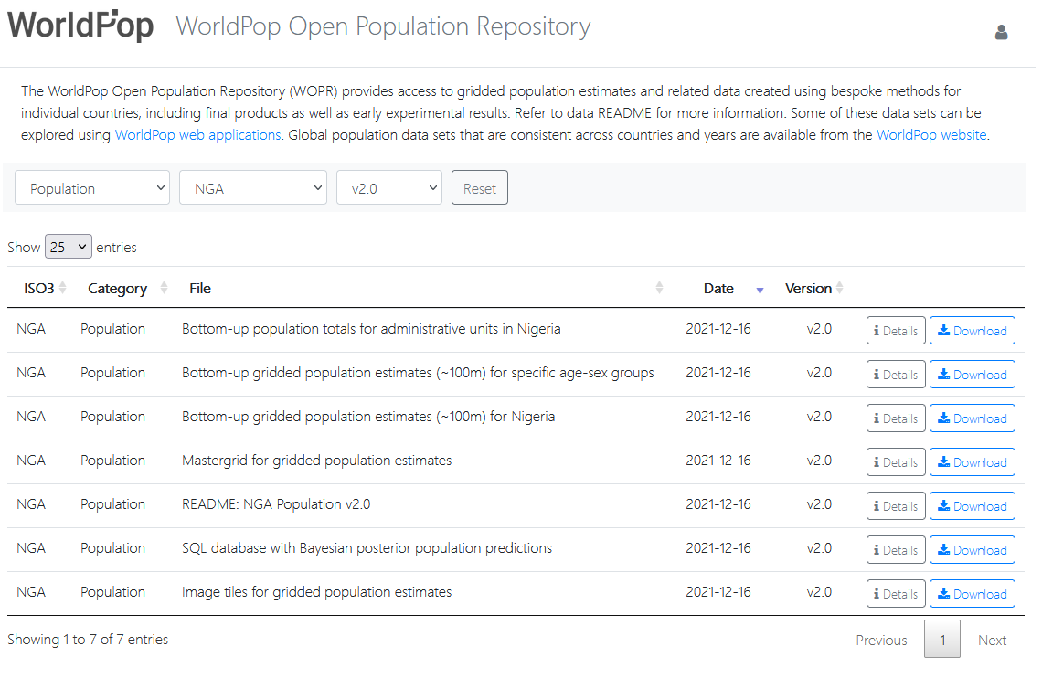
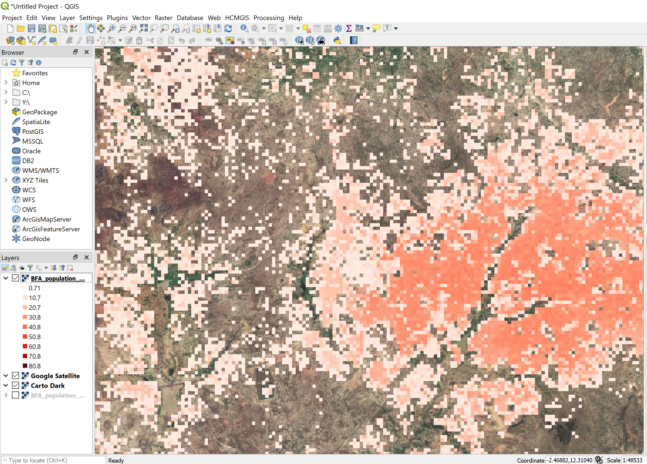
Where to find it?
https://wopr.worldpop.org/?NGA/Population/v2.0

Slide 46
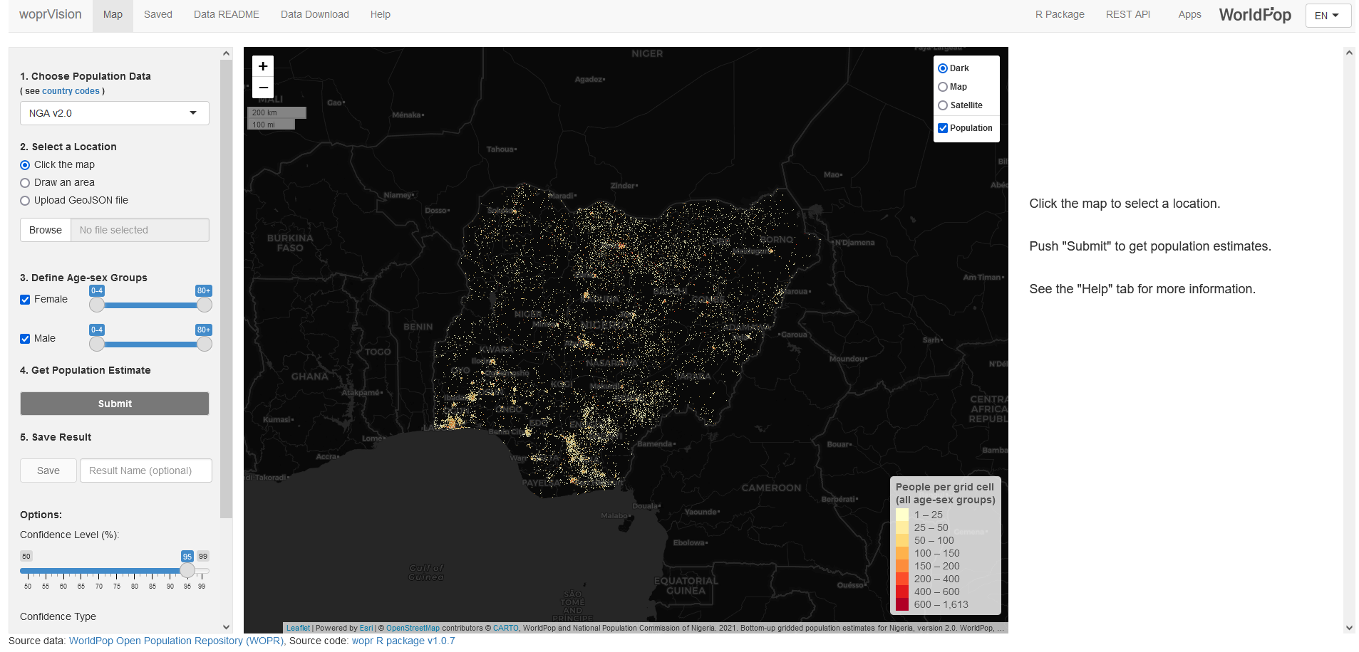
Interactive multilingual app
https://apps.worldpop.org/woprVision/?data=NGAv2.0

Slide 47
Leveraging gridded population
How to use Gridded population

Slide 48
Field support - Vaccination microplanning in the DRC

Slide 49
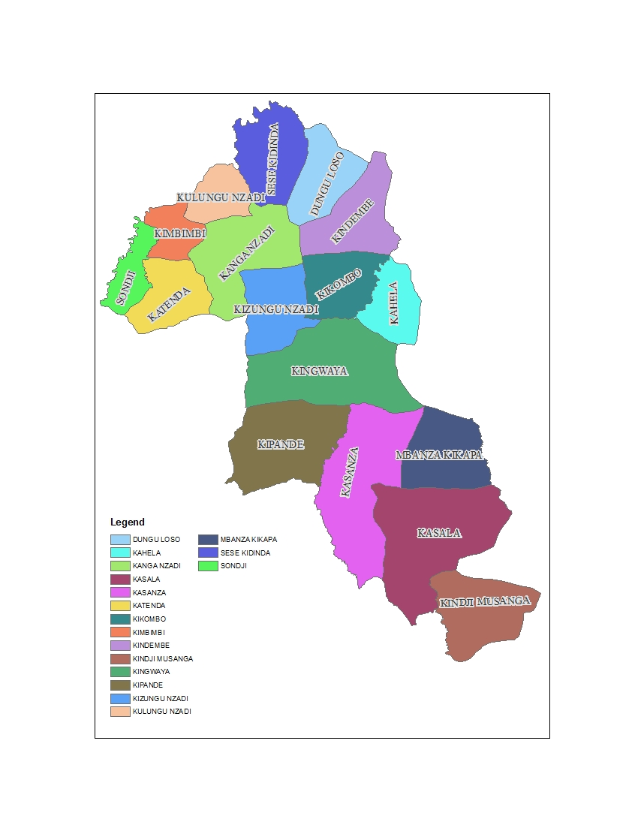
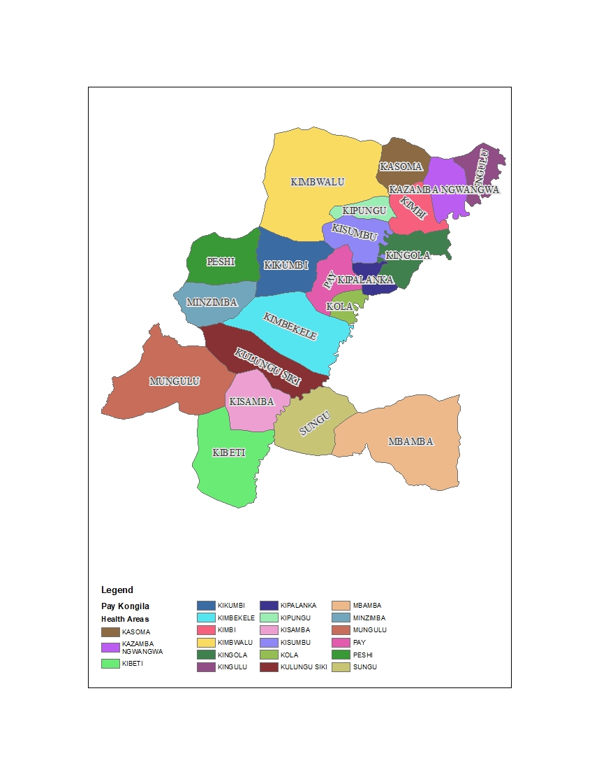
Health areas

Slide 50
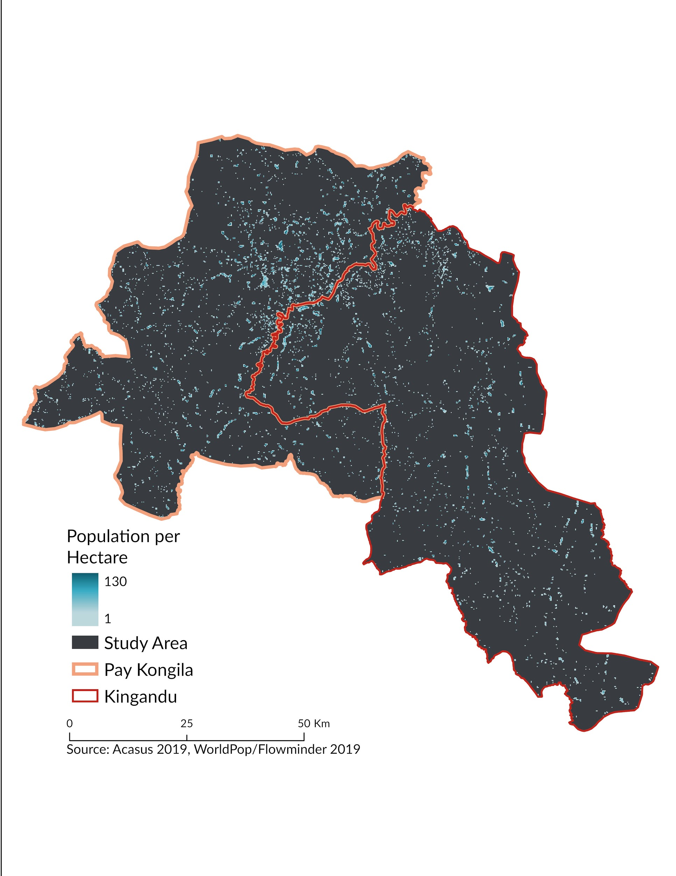

Notes:
Basic overview of the health district/health zone - allow us to look at the distribution of the distribution of the population and get estimates of the number of vials needed
No census since 1984: data: coef 1.03 + some local population count

Slide 51
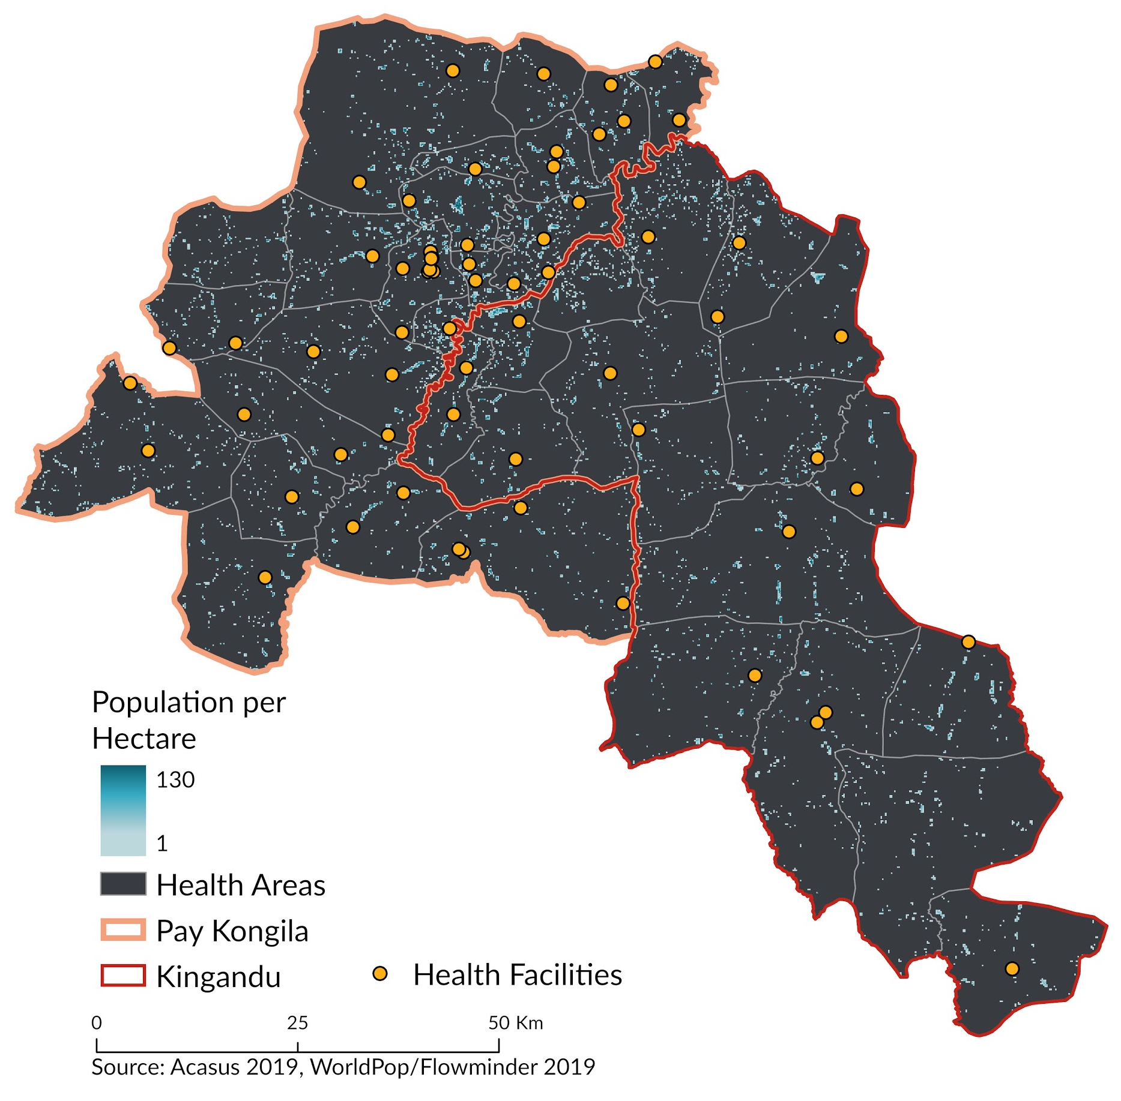
Notes:
Vaccine Distribution and Health Facility Coverage

Slide 52
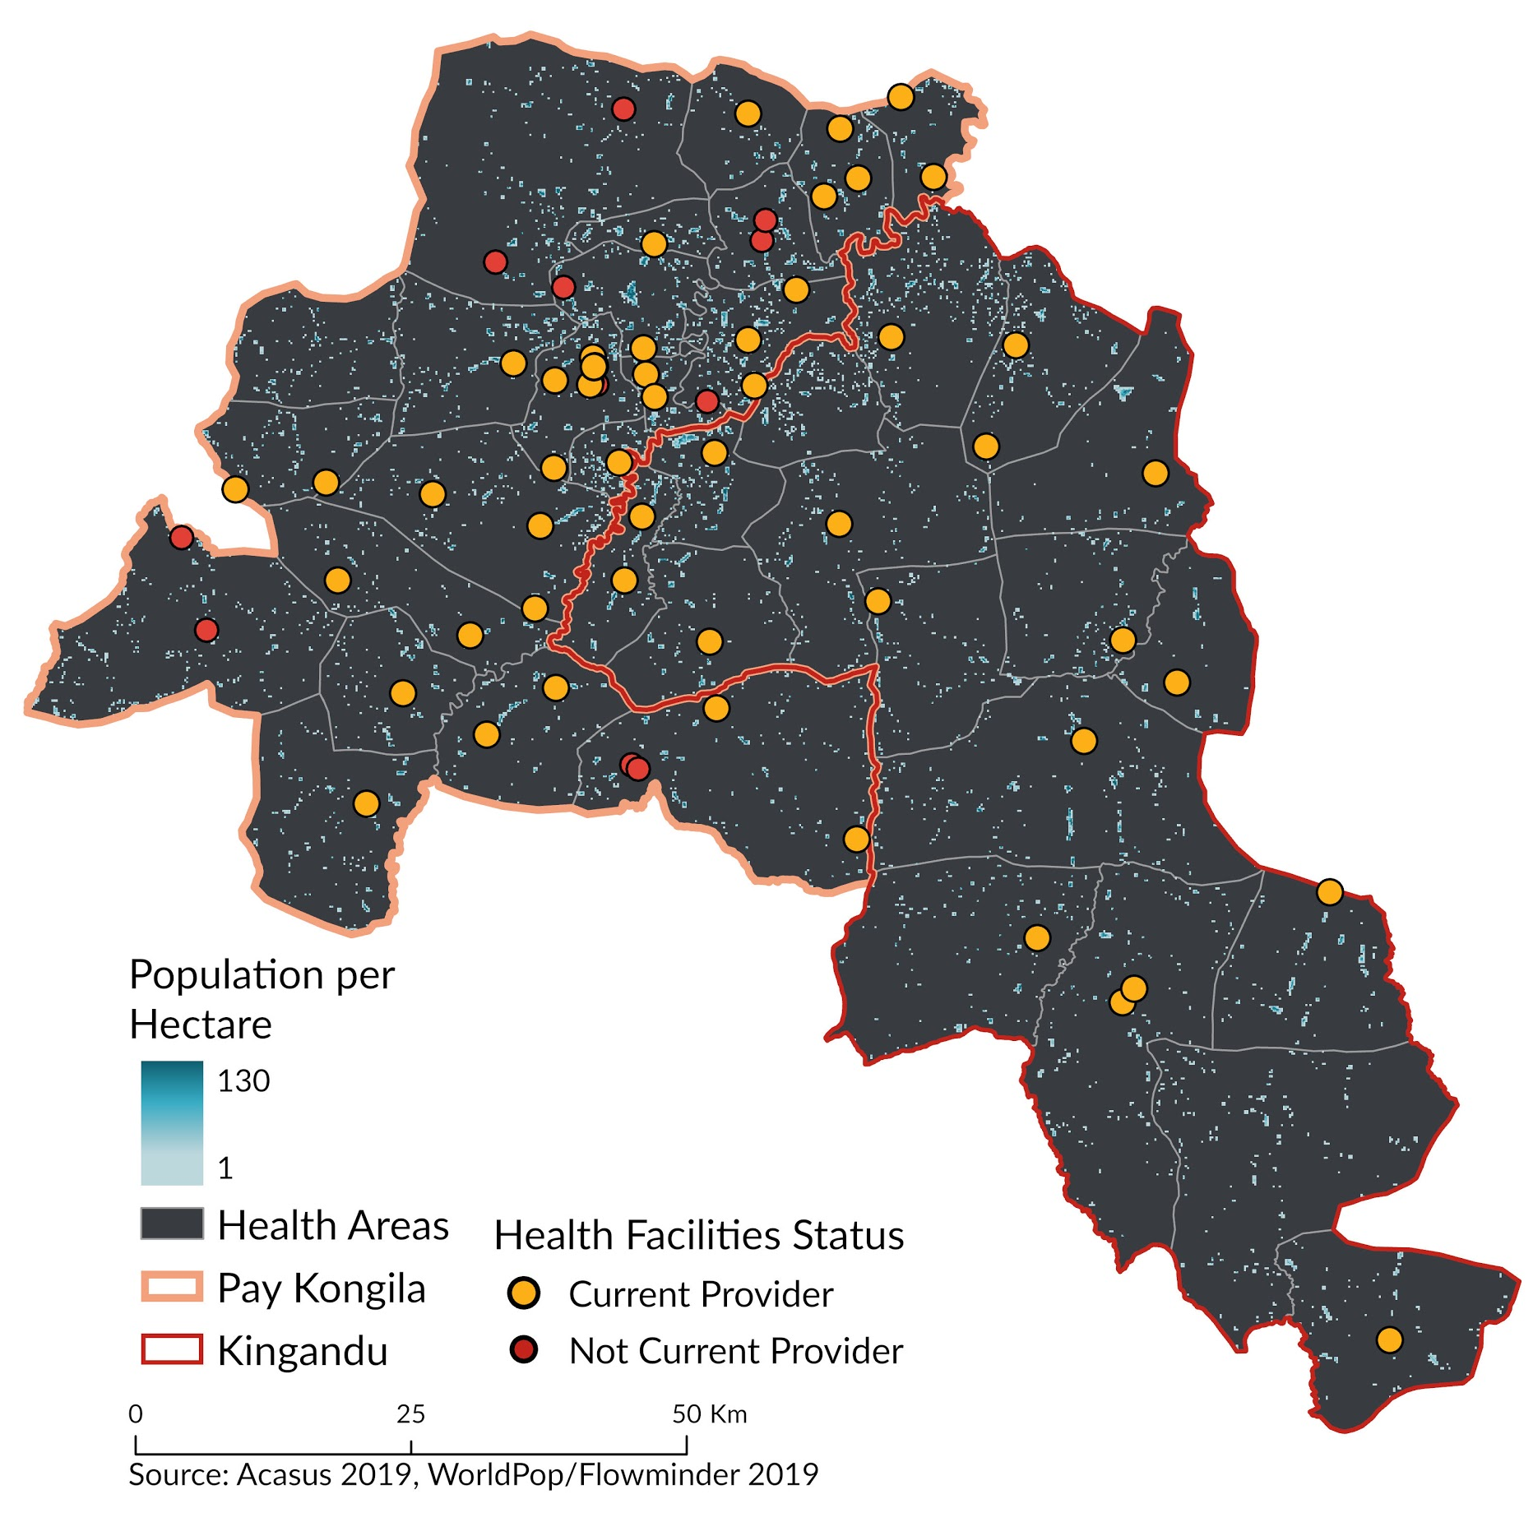

In partnership with
Notes:
Vaccine Distribution and Health Facility Coverage
Not all health facilities currently provide routine vaccination
what is the share of population covered by fixed immunisation centres ?
when we add the supervision data collected monthly by health workers, we can visually see which villages are actually covered by routine immunization or not

Slide 53

In partnership with
Notes:
A 5km buffer was created to analyse coverage and distribution

Slide 54

Zoom sur Kimbwalu

Slide 55


Integrated catchment areas at 1km radius for fixed and temporary posts – Kashere ward, Akko LGA, Gombe state

Slide 56

Map tables for estimated total population per catchment area

Slide 57
Needs assessment School placement optimisation in Nigeria

Slide 58

Kauru, Kaduna
In partnership with Universal Basic Education Commission
Notes:
Catchment areas are overlapped on top of population cells
Areas in which the catchment areas do not overlap with population could be locations where there are either no schools or no data

Slide 59


LGA-level
Ward-level

Slide 60

School Optimisation Tool
Simulated School Placement (200 schools)

Slide 61
Other use cases

Slide 62



Designing programmes
Settlement maps, population data, and building footprints enable cost-effective plans for universal electricity access.
Source: Vija Modi, Department of Earth and Environmental Engineering, Columbia University

Slide 63



Enhancing statistical power
Sampling Frames
Sample units
More accurate sampling frames that better capture differences in household characteristics across space
Thomson et al. Int J Health Geogr (2017) 16:25 DOI 10.1186/s12942-017-0098-4

Slide 64
Do you have any particular use case idea?
ⓘ Start presenting to display the poll results on this slide.

Slide 65
Hands-on
How to use Gridded population

Slide 66
The challenge
How many women of childbearing age are struggling to access maternal health services in Calabar South?

Slide 67
Set up
- https://github.com/wpgp/SICSS-calabar-gridded-population

Slide 68
Did you manage to download the scripts?
ⓘ Start presenting to display the poll results on this slide.

Slide 69
Do you manage to read the data in?
ⓘ Start presenting to display the poll results on this slide.

Slide 70
Do you manage to map LGAs in Nigeria?
ⓘ Start presenting to display the poll results on this slide.

Slide 71
How many health facilities can we find in Calabar South?
ⓘ Start presenting to display the poll results on this slide.

Slide 72
How many health facilities are offering tertiary services in Calabar South? Hint: check the attribute `type`
ⓘ Start presenting to display the poll results on this slide.

Slide 73
What are the categories of health services offered in Calabar South? Hint: check the `category` attribute
ⓘ Start presenting to display the poll results on this slide.

Slide 74
How many people are living in 1km of Anantigha Primary Health Care?
ⓘ Start presenting to display the poll results on this slide.

Slide 75
How many people are not living in a 1km of an health facility?
ⓘ Start presenting to display the poll results on this slide.

Slide 76
How many maternity homes are listed in the LGA?
ⓘ Start presenting to display the poll results on this slide.

Slide 77
How many people are not living in a 1km distance of a maternity center?
ⓘ Start presenting to display the poll results on this slide.

Slide 78
How many people are living at more than 5km from a maternity?
ⓘ Start presenting to display the poll results on this slide.

Slide 79
How many women of childbearing age are living at more than 5km from a maternity?
ⓘ Start presenting to display the poll results on this slide.

Slide 80
What about the number of women of childbearing age living at more than 5km from a maternity in the country?
ⓘ Start presenting to display the poll results on this slide.

Slide 81
THANK
YOU

